Slide 1
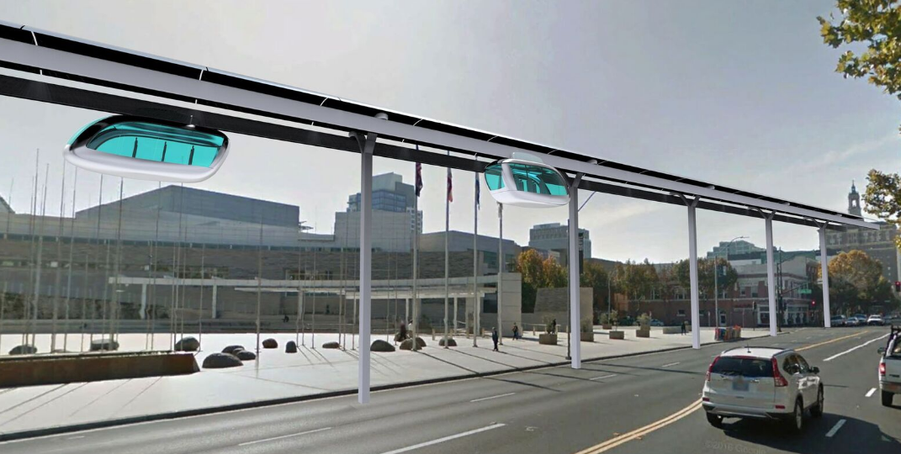
S.P.A.R.T.A.N Superway
2020-2021 Senior Design Project
A Solar Powered Automated Rapid Transit Ascendant Network

Slide 2
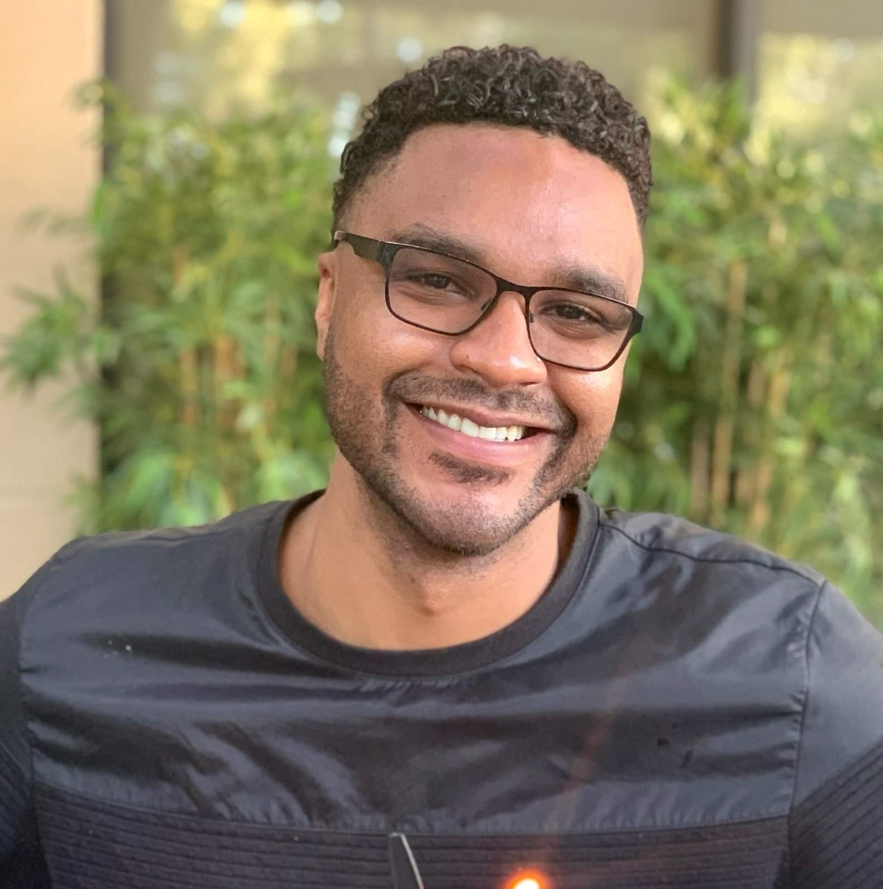
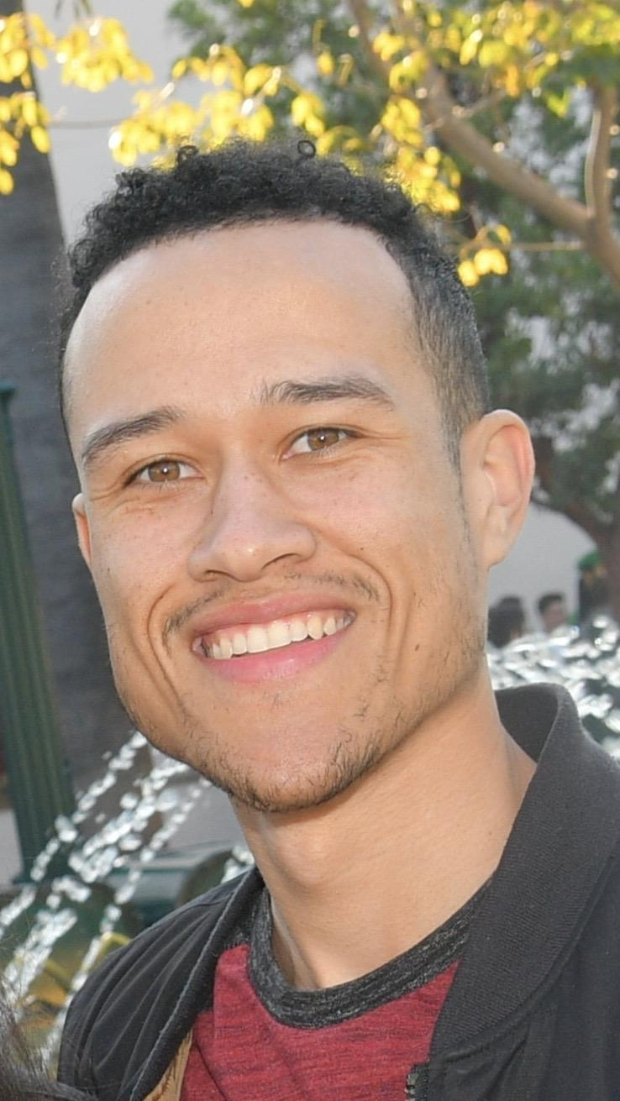
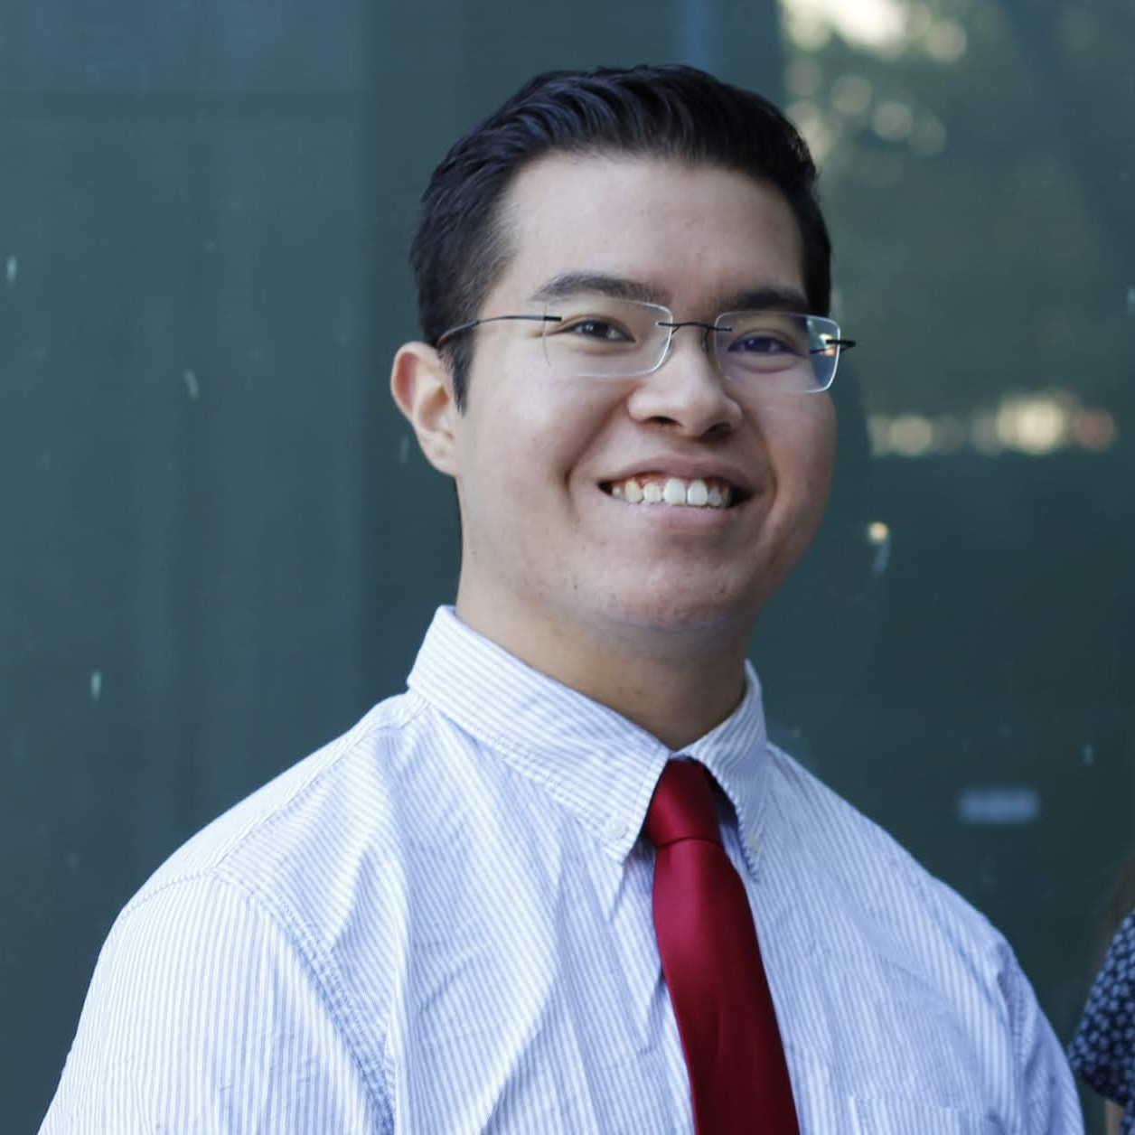
Mentors
Greg White
Project Manager
Track Design Team
Gregory.L.White1@gmail.com
Carlos Ortega
Track Design Team
IoT Team
Robert Skinner
Chassis Team
Track Design Team
Brandon Scully
Switch Arm Design Team
Chassis Team
Notes:
Script: Thank Greg,

Slide 3
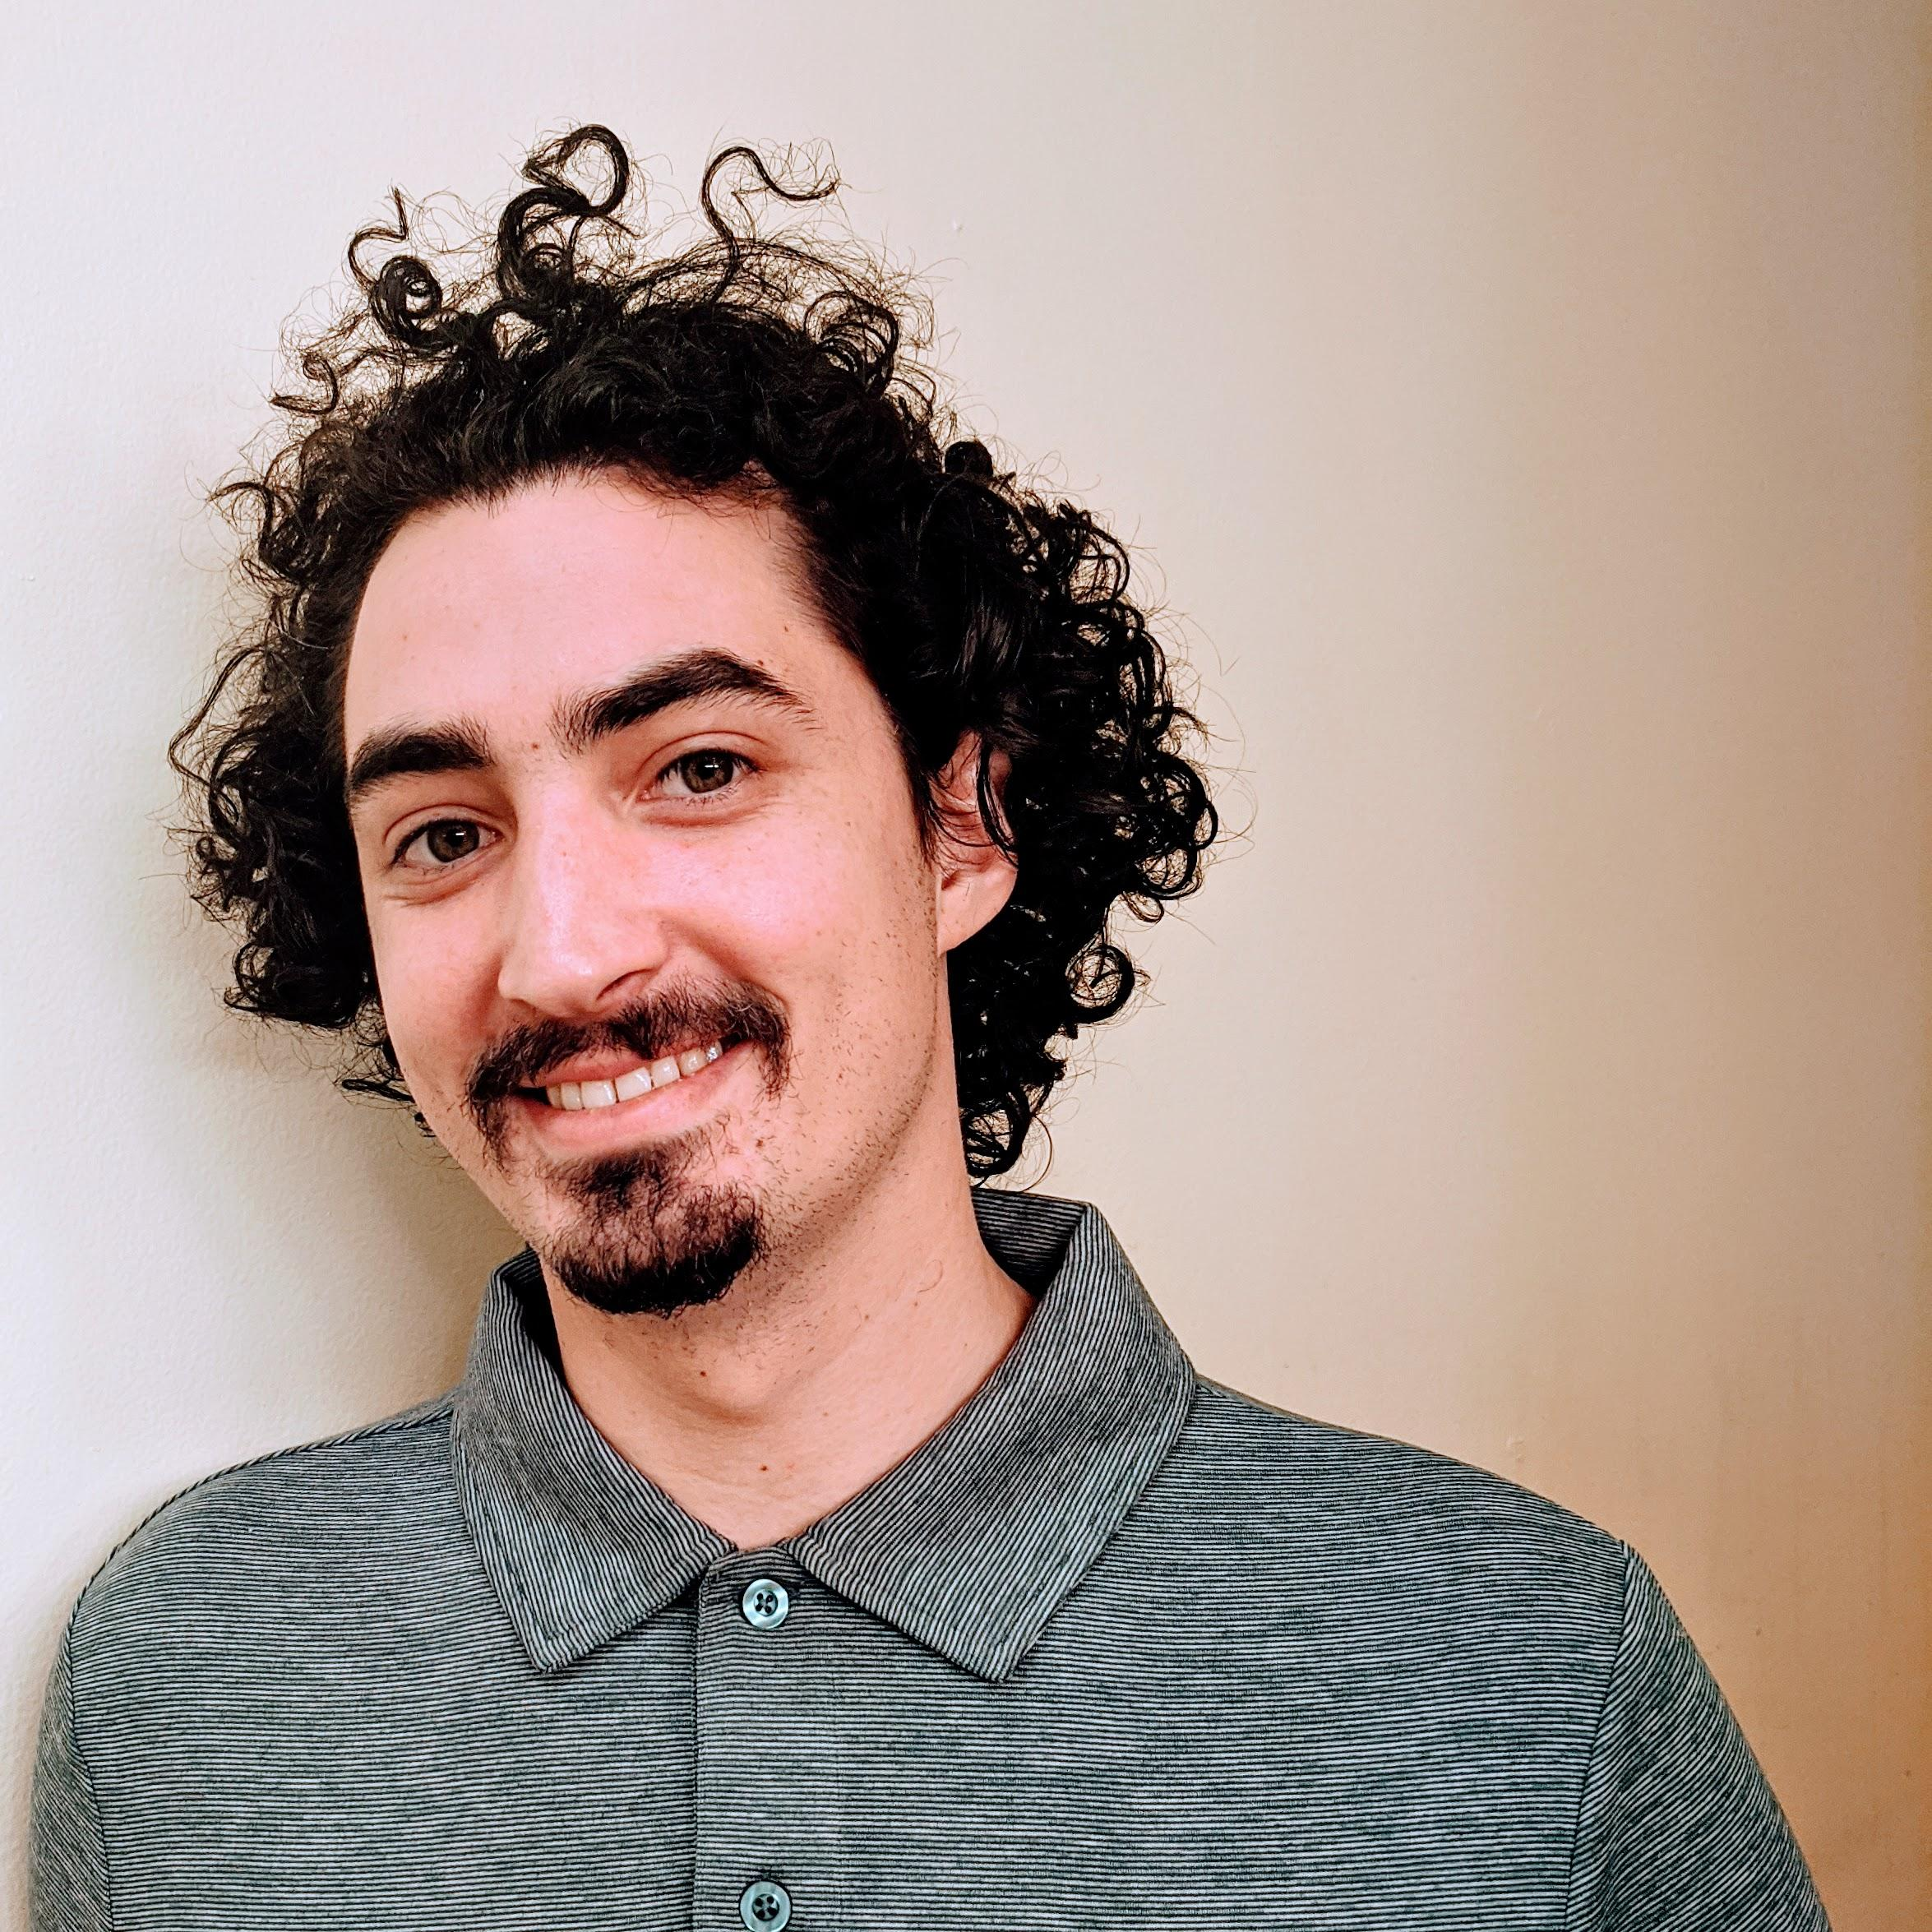
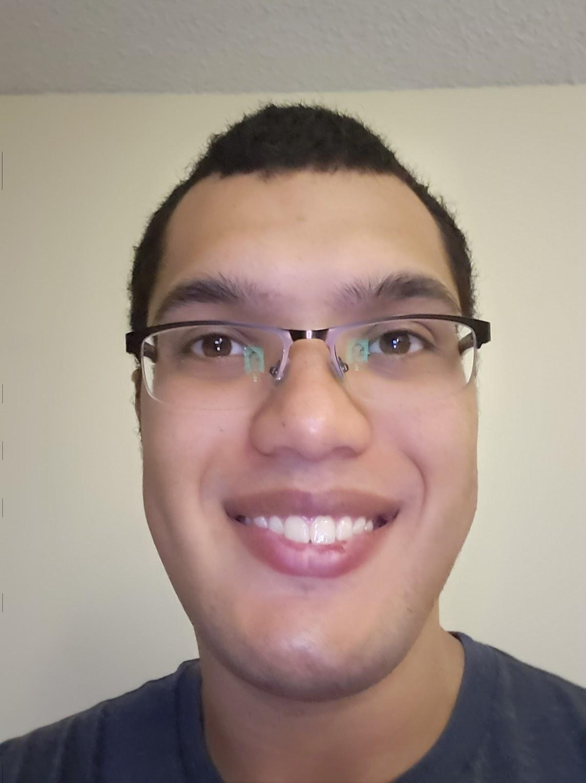
Mentors
Lucas Lim
IoT Team
lucasdukyulim@gmail.com
Logan Fansler
IoT Team
Keanu Heggem
Switch Arm Design Team
Chassis Team
Jonathan Legasca
Track Design Team
Notes:
Script: Thank Greg,

Slide 4
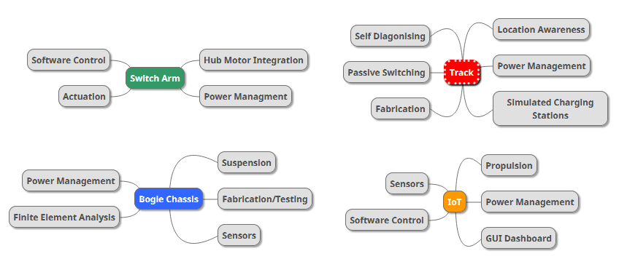

Slide 5
IoT
By: Carlos Ortega, Logan Fansler, and Lucas Lim
Notes:
Script: Thank Greg,

Slide 6
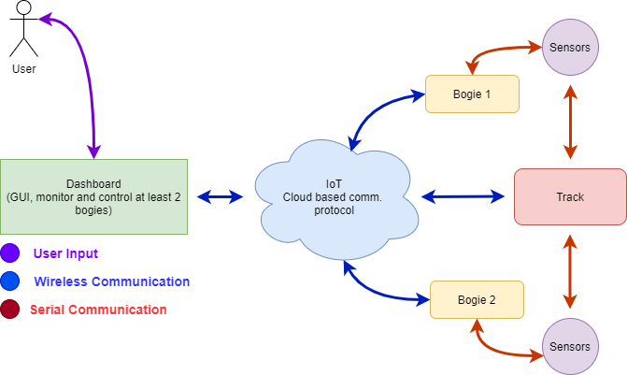
The IoT team is responsible for integrating the control system of the bogie and the track
Notes:
Introduction Slide
Project scope and why it is important:
Integrate sensors included in bogie and track, by writing the overall code;
Create a dashboard to display all the data;
Successfully control bogies remotely (MQTT);
Create logic behind bogie control (collision avoidance and switching);

Slide 7
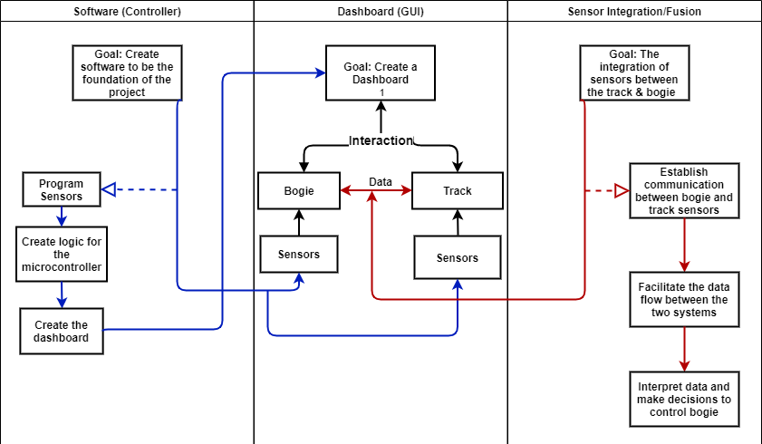
The IoT team has objectives broken down into three categories: Software, Dashboard, and Sensor Integration/Fusion
Notes:
Script: As the IoT team, we are the foundation for the other projects here at Spartan Superway. As a result, we have many tasks and responsibilities that we have broken down into three categories: Software, Dashboard, and Sensor Integration/Fusion. The dashboard is at the center of the project since the rest of the project revolves around it. As Logan went into earlier, the dashboard is for a user to communicate to the bogie and track sensors while they give data back for the user to interpret and make decisions. On the left is the software category. This is where the IoT team programs the bogie/track sensors as well as create the logic for the microcontroller and create the dashboard itself. The microcontroller the IoT team uses is the ESP32, which is able to use WiFi

Slide 8
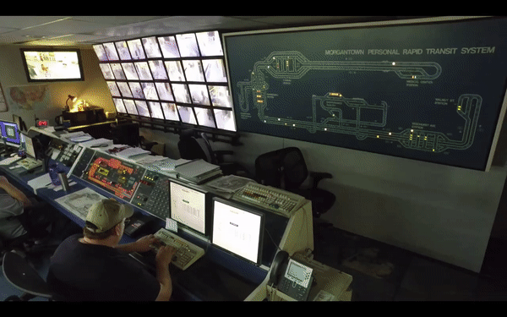
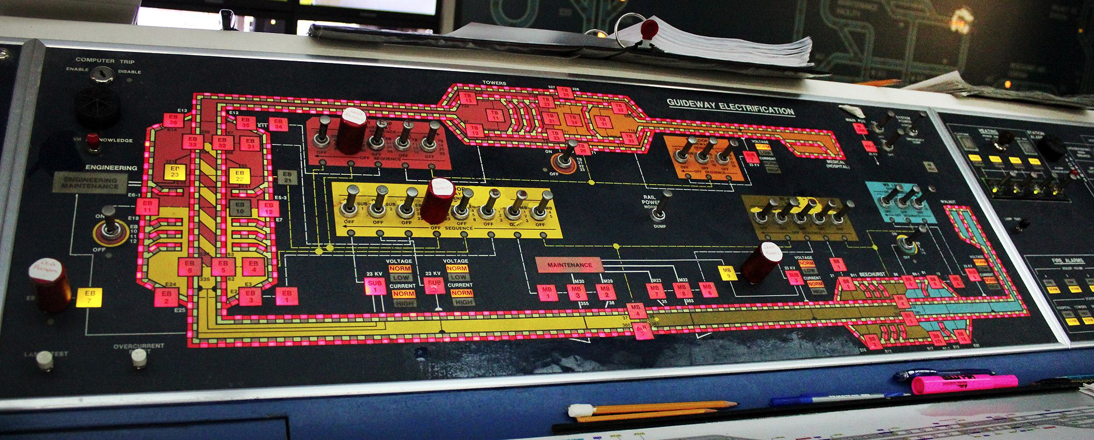
West Virginia University designed a control system for their private rapid transportation
Notes:
Script: West Virginia University has a working Private Rapid Transit system with a control room and a dashboard. Their room is a great example of what we are looking for from the IoT team, but instead of having physical buttons and LED lights, the idea is to implement this dashboard and sensors data on a web server or phone application.
Example of Control system for WVU PRT
Different because our system will not be hardware, will be through web/app

Slide 9
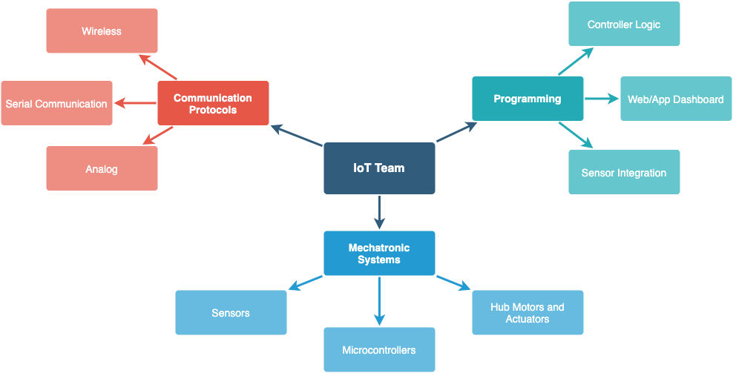
The IoT team manages mechatronic systems, system programming and communication protocols
Notes:
The IoT team manages mechatronic systems, system programming and communication protocols. Our members will learn skills in all these areas. For example, the IoT team will work with sensors, microcontrollers, hub motors and actuators. The team will develop the controller logic, the web/app dashboard and the sensor integration. In addition, the IoT team will learn to work with wireless, serial and analog communication.
Skills and instruments:
Mechatronic systems (MCU, drivers, motors, sensors);
Programming (MCU & GUI);
Controller logic:
Collision avoidance
Switching logic
Web/App Dashboard (GUI)
Sensor Integration
Integrate sensors in the track and bogie with code
Data analysis
Communication (Mosquitto & Serial communication)
bogie/track + dashboard (MQTT)
Controllers in the same bogie (VESC and ESP32 - UART)
Bogie + bogie (MQTT)

Slide 10
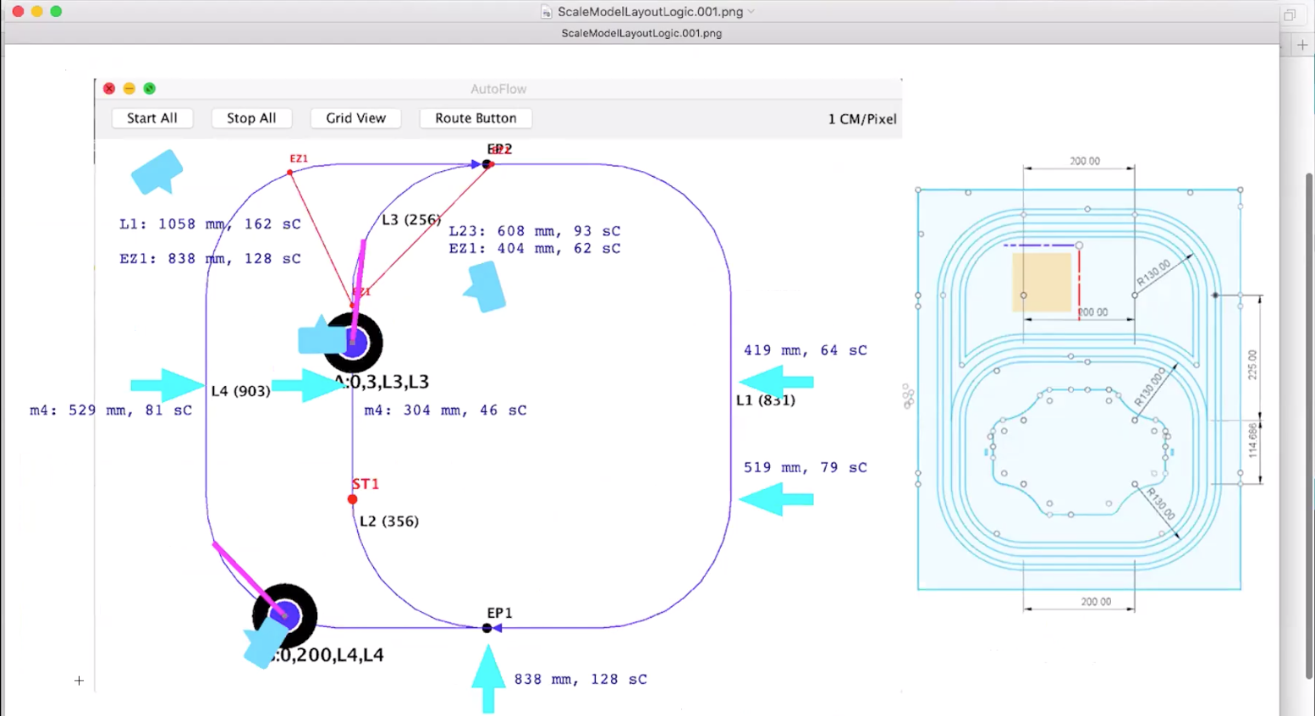
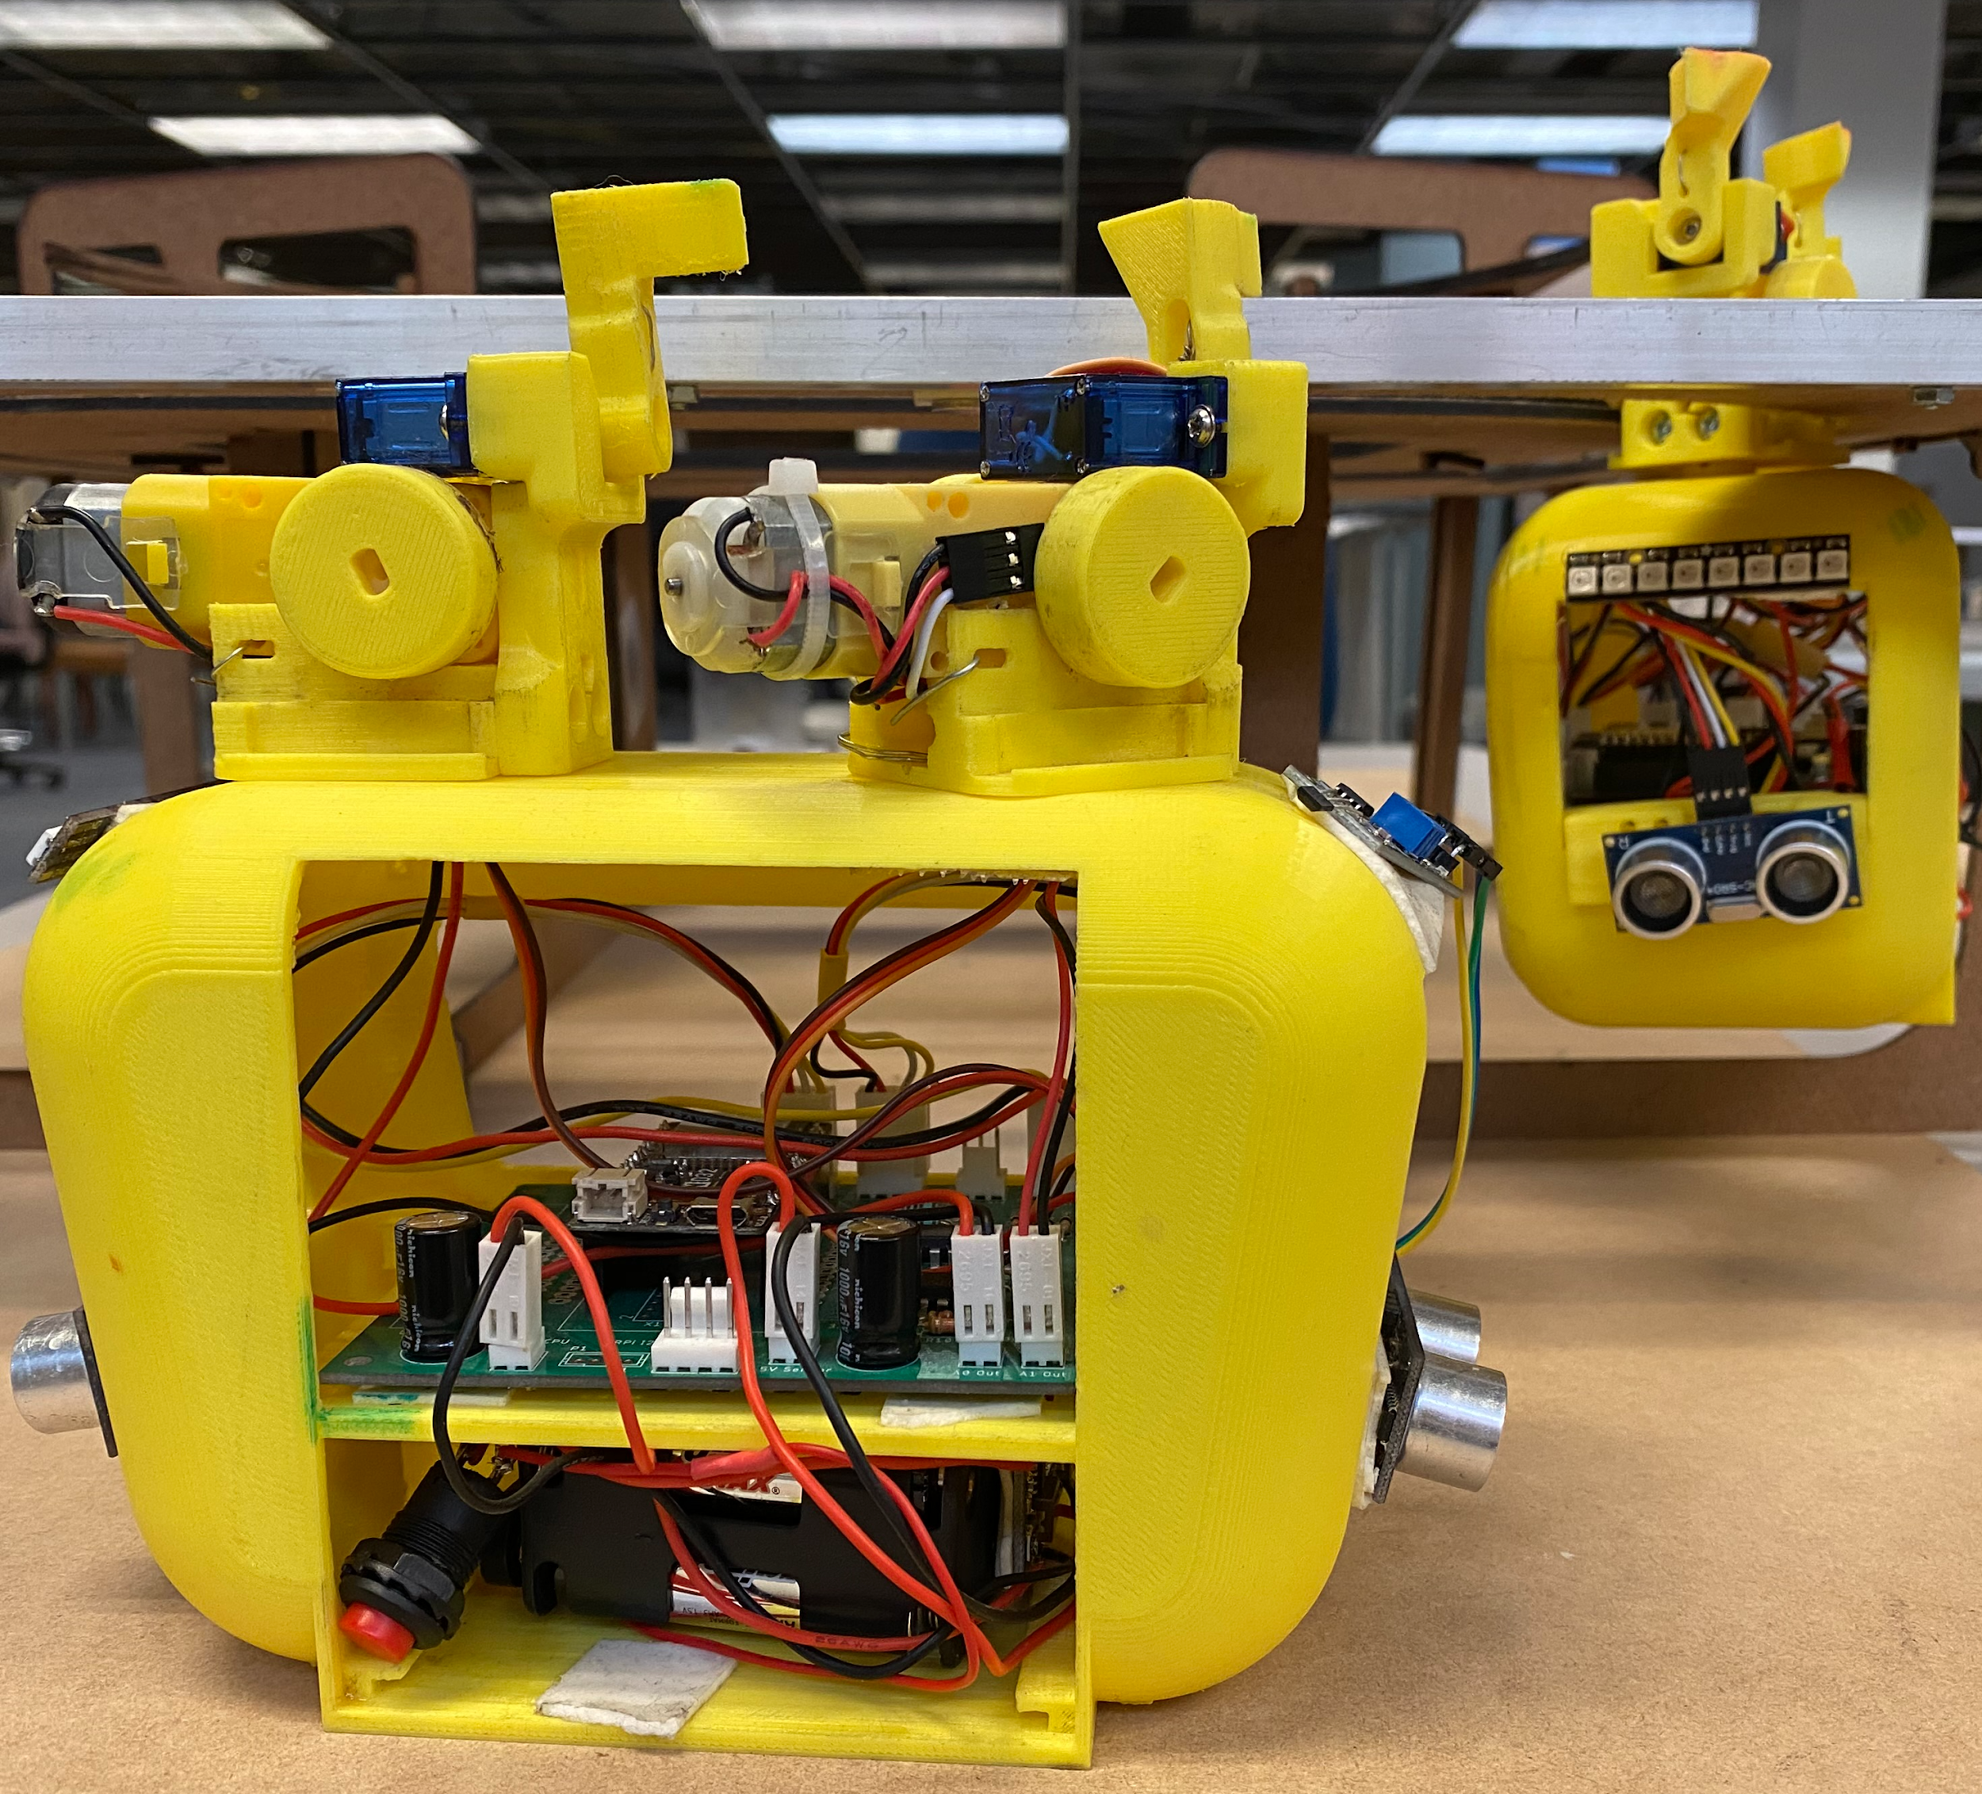
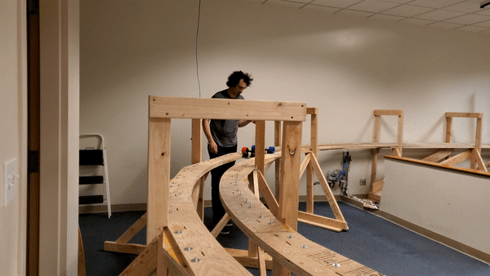
Spartan Superway already has functioning small-scale bogies but no dashboard
Notes:
The Spartan Superway already has functioning bogies and a controller logic running on a small scale prototype. With this prototypes, the IoT team will be able to test all the code developed for the dashboard, bogie and the intelligent track.
Progress until now:
No progress on the creation of a GUI other than AutoFlow, since remote monitoring is a new section for the Spartan Superway overall;
But there is progress in the bogie control program (video of switching bogie in suitcase model)

Slide 11
IoT team is expected to deliver a complete dashboard with a working bogie/track logic
Notes:
Script:
Finally, the IoT team will deliver a complete online dashboard, that allows the operator to control the bogies remotely and that shows all relevant data in real time. In addition, the IoT team will provide the control logic behind each bogie and the track, making sure to take into consideration: collision avoidance, bogie tracking, switching logic and communication over cloud.
Final goals & expectations
Complete dashboard with real-time data;
Remote control of bogies;
Working bogie/track logic (with multiple bogies on the track);

Slide 12
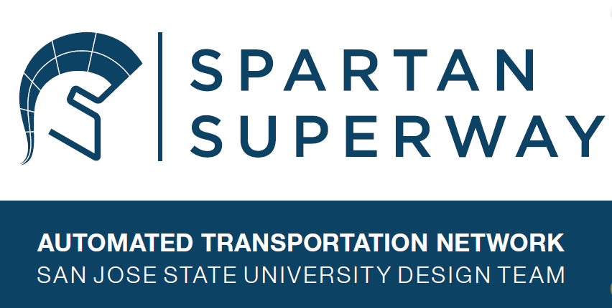
Come and Join our Team!

Slide 13
Spartan Guideway

Slide 14
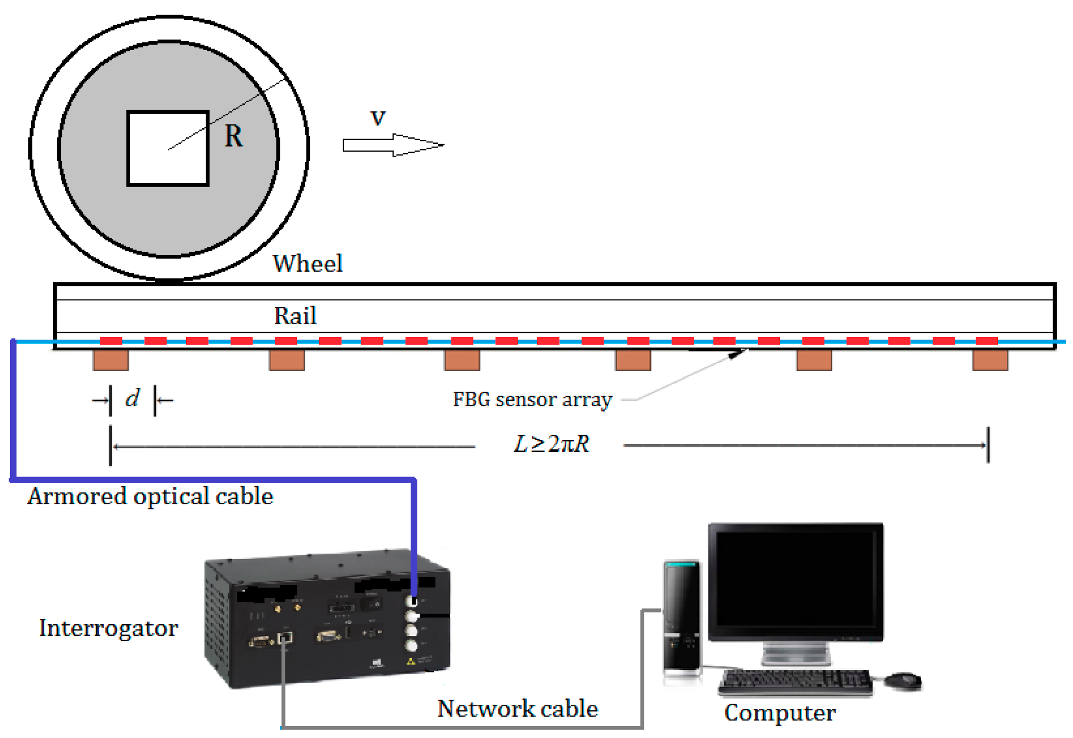
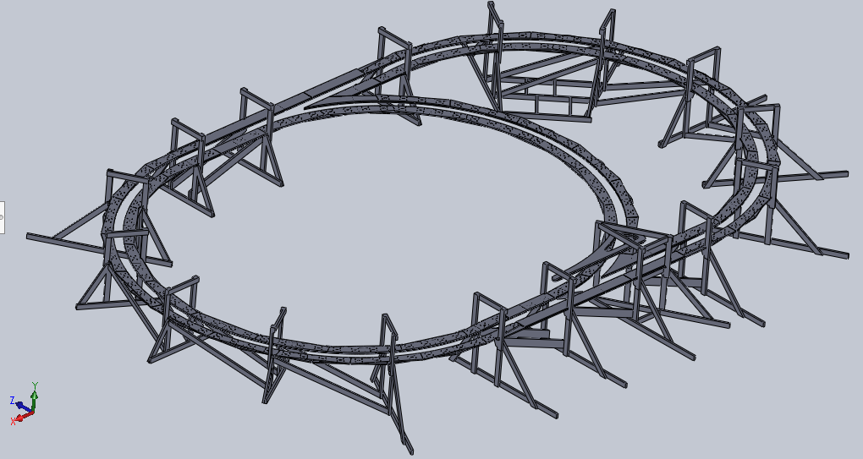
The track team is focused on building the track elements and implementing innovative mechatronic features onto it.

Slide 15
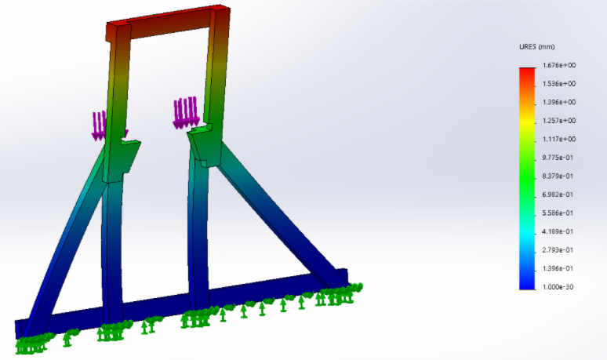
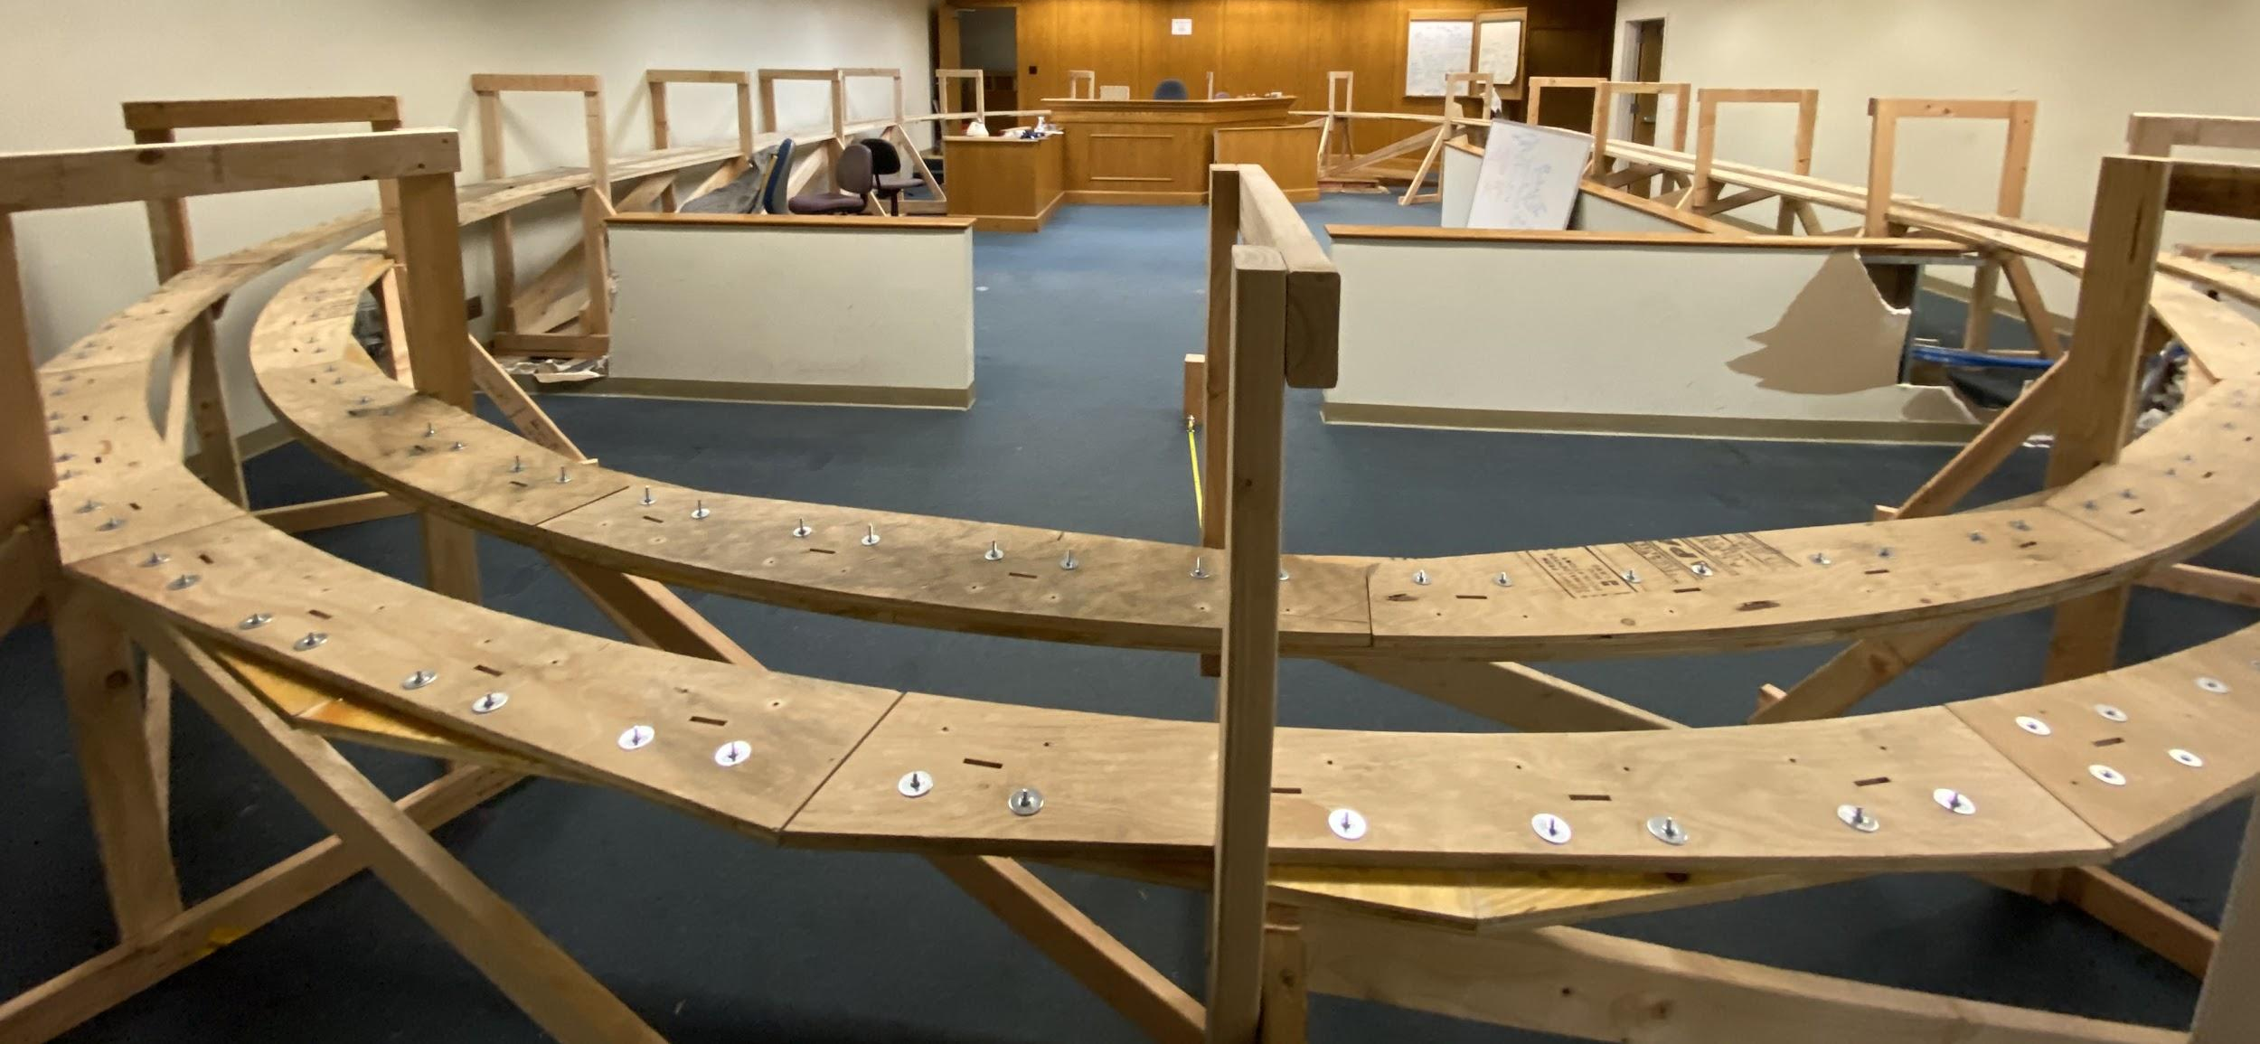
Mechanical Design will include creating an overall layout of the track that you will test using FEA
Notes:
Mech Design in creating overall layout of track, including switch section. Mechatronics in implementing the sensors into the track for various functions. Knowledge of mechanics of materials, programming, and CADing in Solidworks (parts, assemblys, drawings) are recommended. FEA analysis must also be done for sections of the track, and possibly the entire track a whole. FEA can be done using any software, but ANSYS and Soldiworks are encouraged.

Slide 16
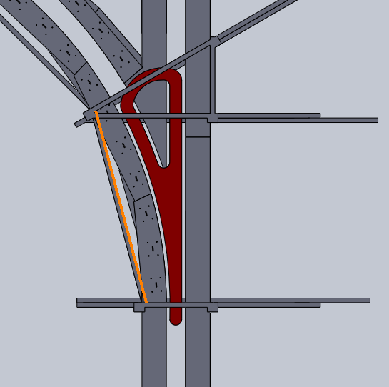
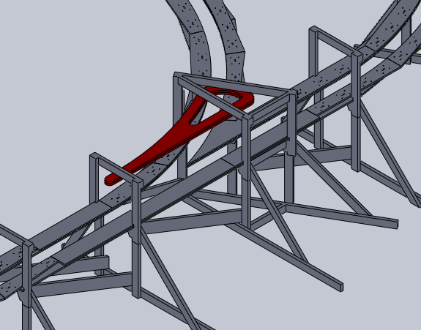
An important design for the track is called the “Y” junction, which is where the bogie will be able to transfer from one route to another.
Notes:
This design must be in close conjunction with the switch arm team and their design. The Y switch and switch arm designs have to compliment each other in a flawless way. Work with the switch arm team to ensure that any points of failure are discussed and accounted for by both teams

Slide 17
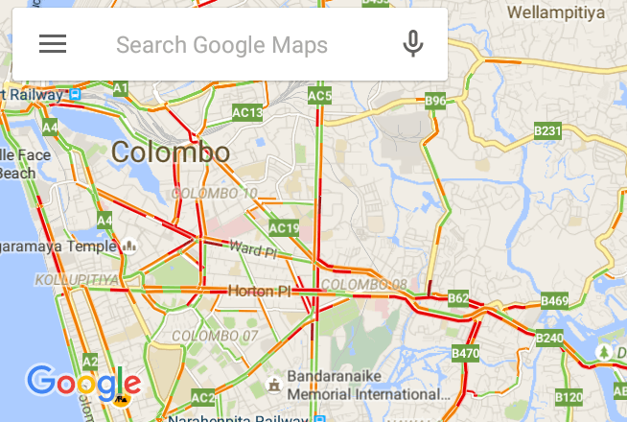
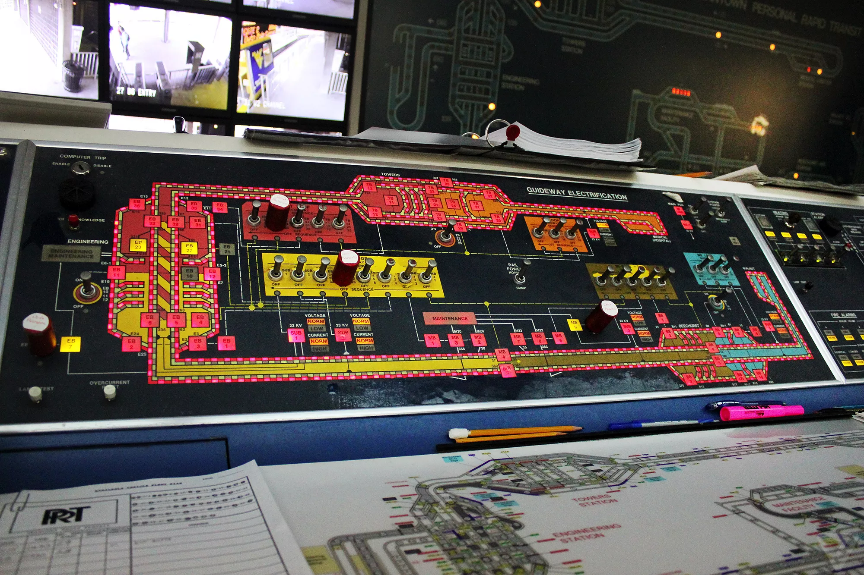
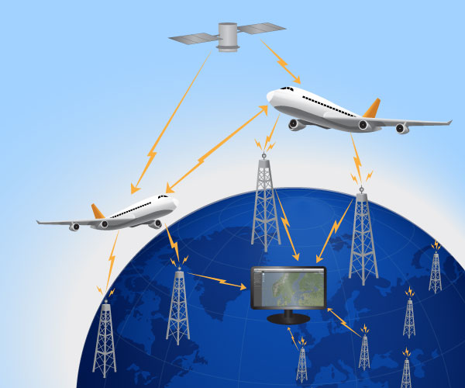
Sensors on the track will serve two purposes; monitoring the position and motion of the bogie, and monitoring the conditions and health of the track.
Notes:
The only constraints to the sensors are cost and effectiveness. Obviously sensors too expensive will be rejected, but cheap, unreliable sensors will also be dissuaded. Other than that, be creative with what sensors to use. Think about the logic for the sensors code and how it can be implemented or changed for the goals of the track. These sensors should also be connected by a harnness that can easily be installed onto the track. Think of the sensors working like google maps or air traffic control.

Slide 18
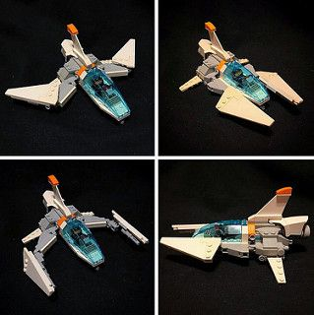
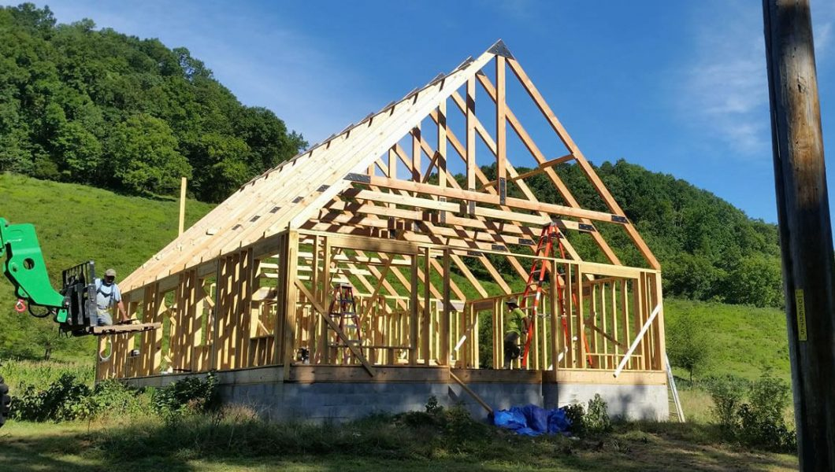
The components of the track will be designed to be interchangeable, allowing for alternate configurations to be created using the same pieces.
Notes:
Try to avoid designs that can only be used in one orientation. Of course specific components will only fit one design, but use those specific components to build an assembly that can be interchangeable. Also, think about where each component can be found. Designing with all 2x4 pieces of wood would be great because they are cheap and easy to come by at any lumber yard. A 1¼” x 3⅔” piece can be made from a 2x4, but takes time and work to get it to that specific size. Less specific parts, more common parts.

Slide 19
The end goal for the track team is to have a track that will withstand the forces of the bogie, while implementing sensors that monitor multiple aspects of the track and bogie.

Slide 20
Chassis

Slide 21
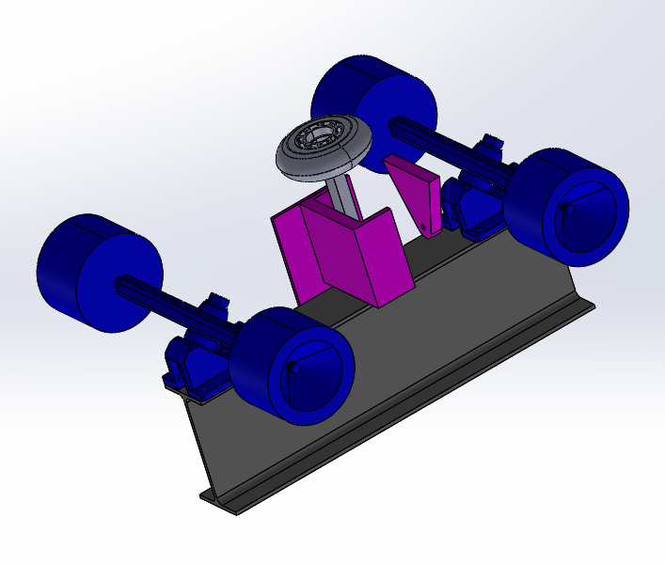
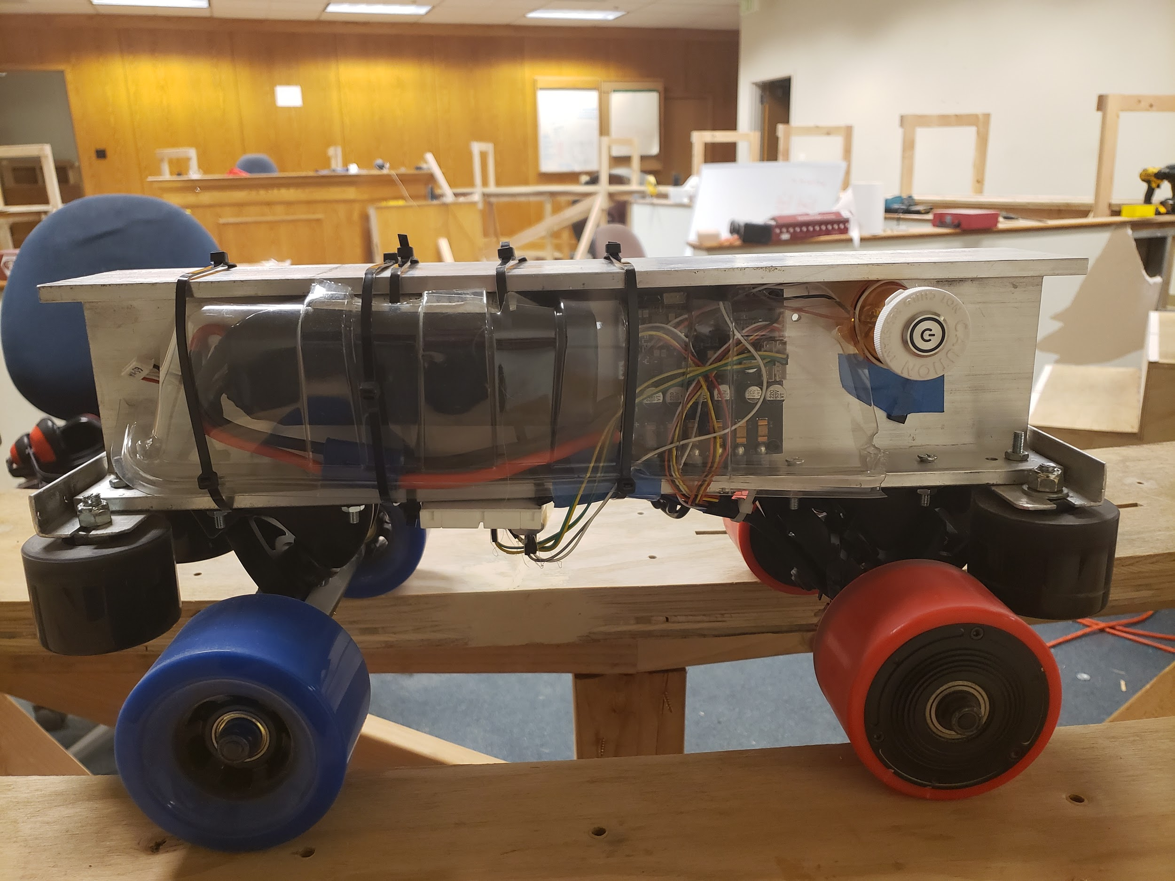
The bogie chassis team is primarily centered around mechanical design

Slide 22
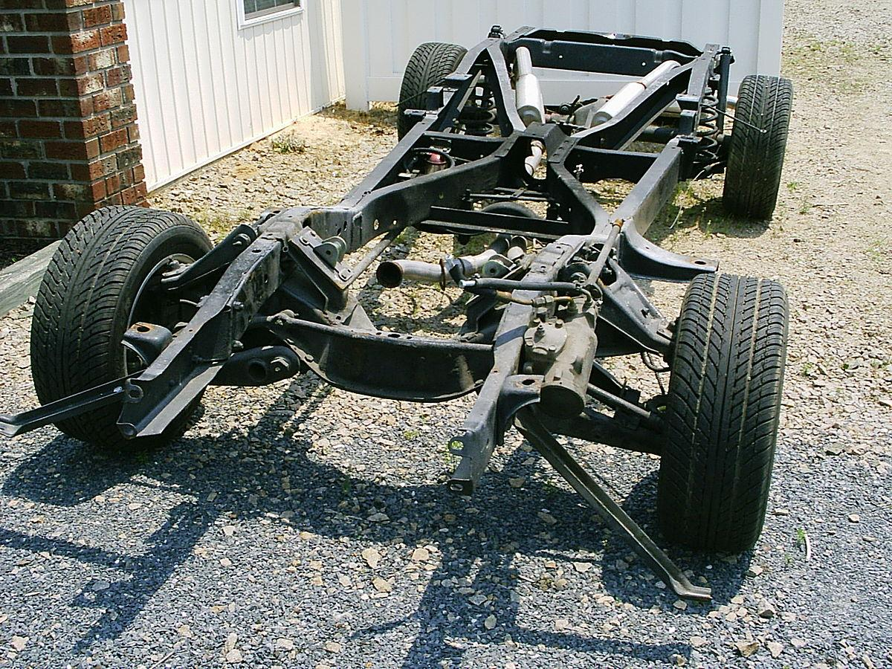
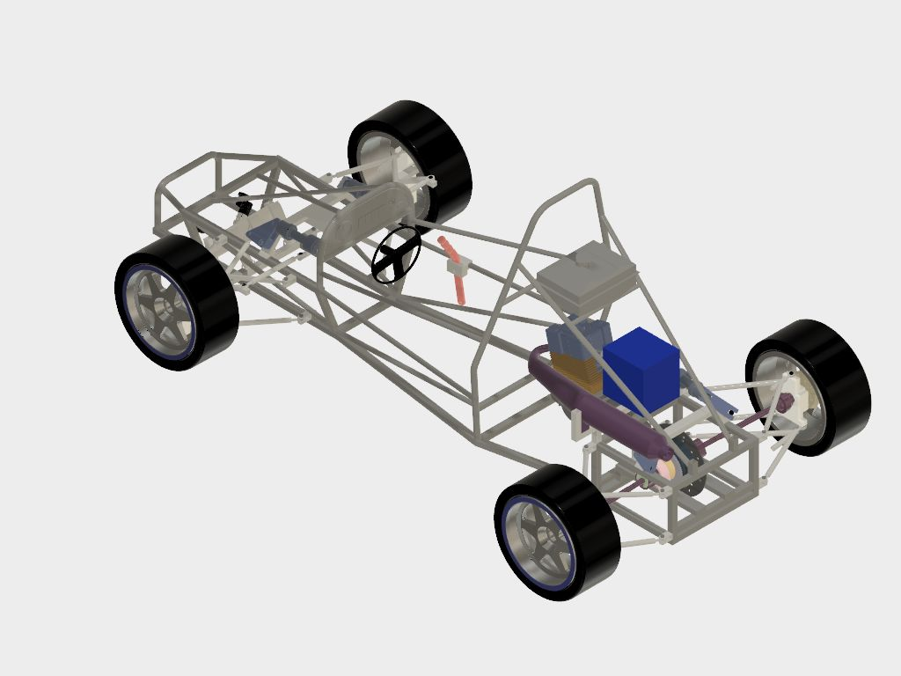
The chassis is the raw frame that holds the motors, sensors, power systems, wheels, and other mechanisms. It has no moving parts, and only serves to physically support the rest of the vehicle

Slide 23
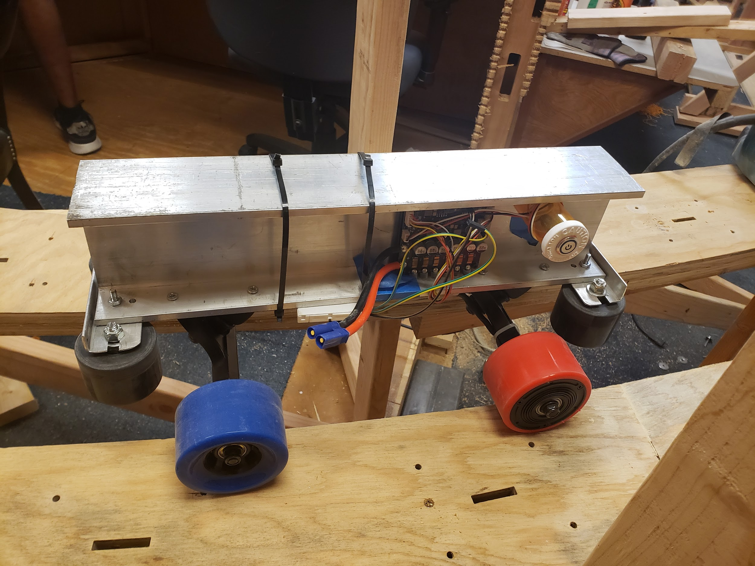
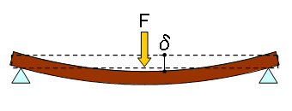
The chassis must withstand nearly all of the forces exerted upon the vehicle, and therefore must be stiff and have a high yield strength

Slide 24
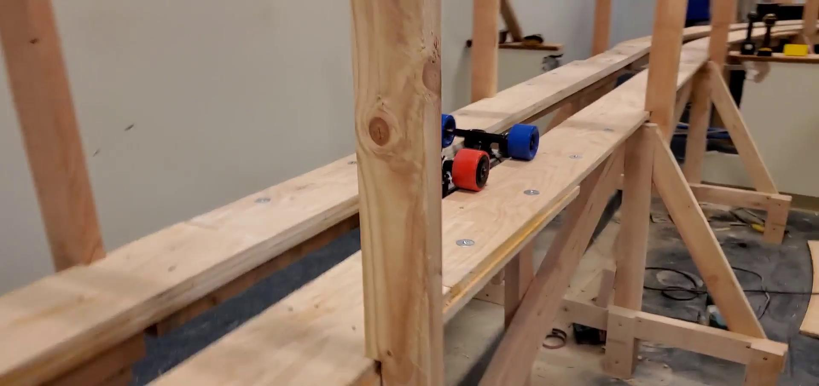
The advising team has made a lot of progress on the bogie and track that they are using.

Slide 25
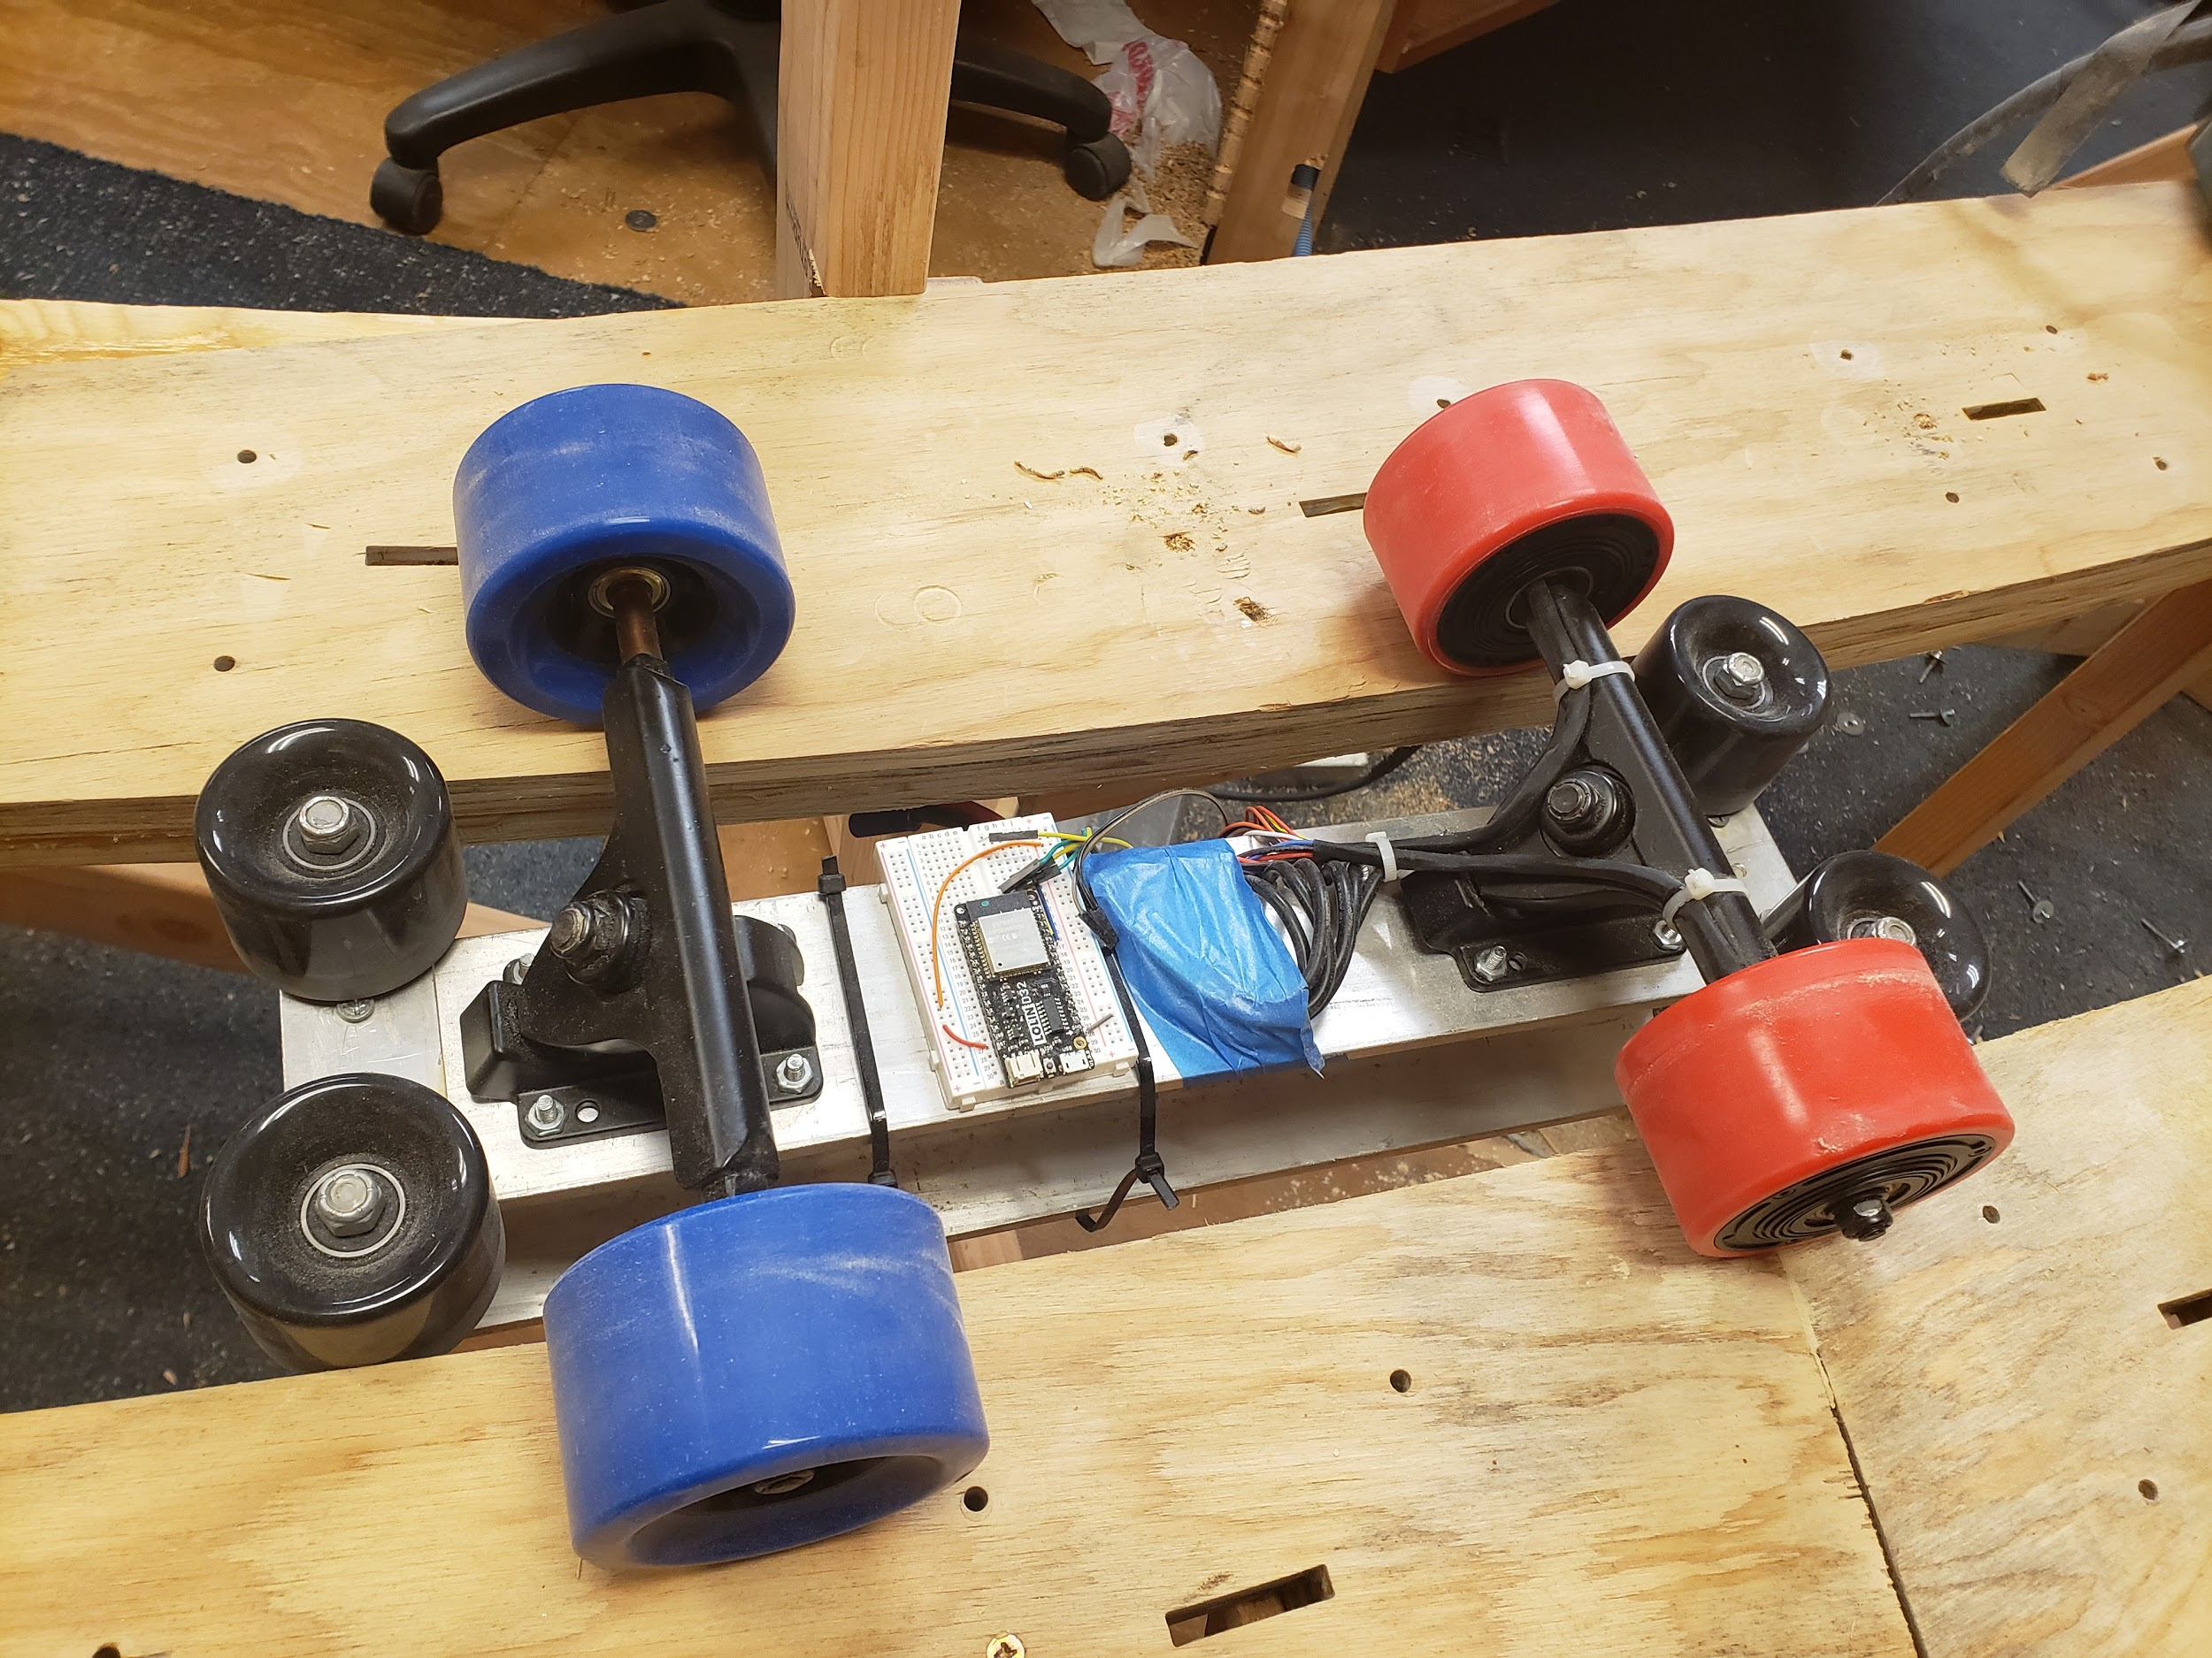
The bogie chassis team is tasked with creating a model frame that can support a switch mechanism, a suspension system, sensors, and a 100 lb vertical load

Slide 26
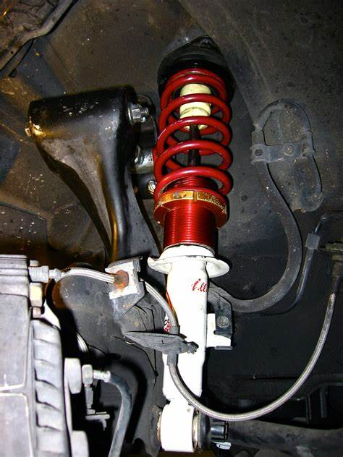
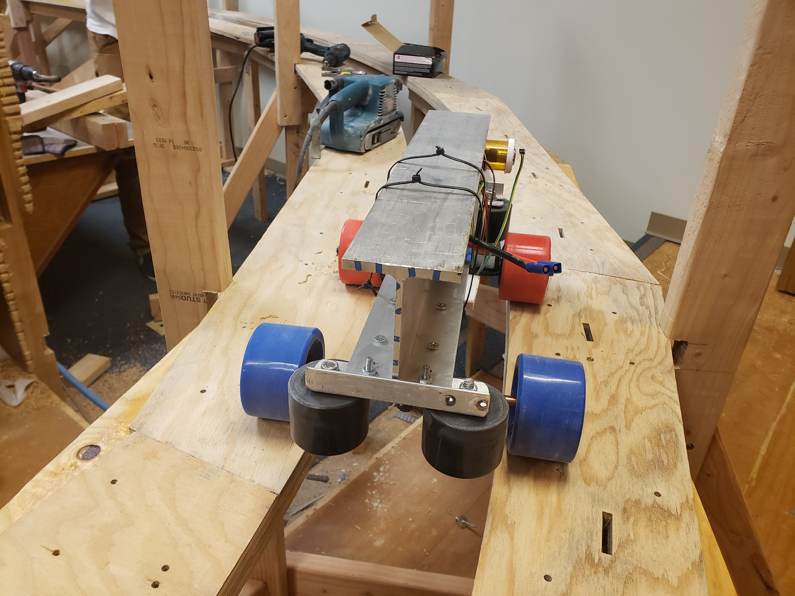
The bogie team is also required to create and run FEA simulation on a CAD model of a suspension system to be mounted on the bogie

Slide 27
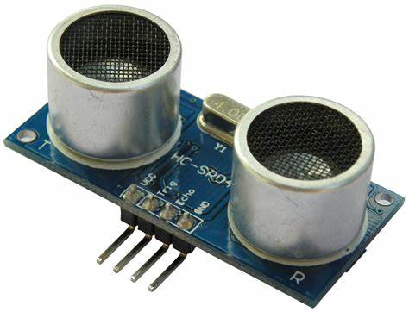
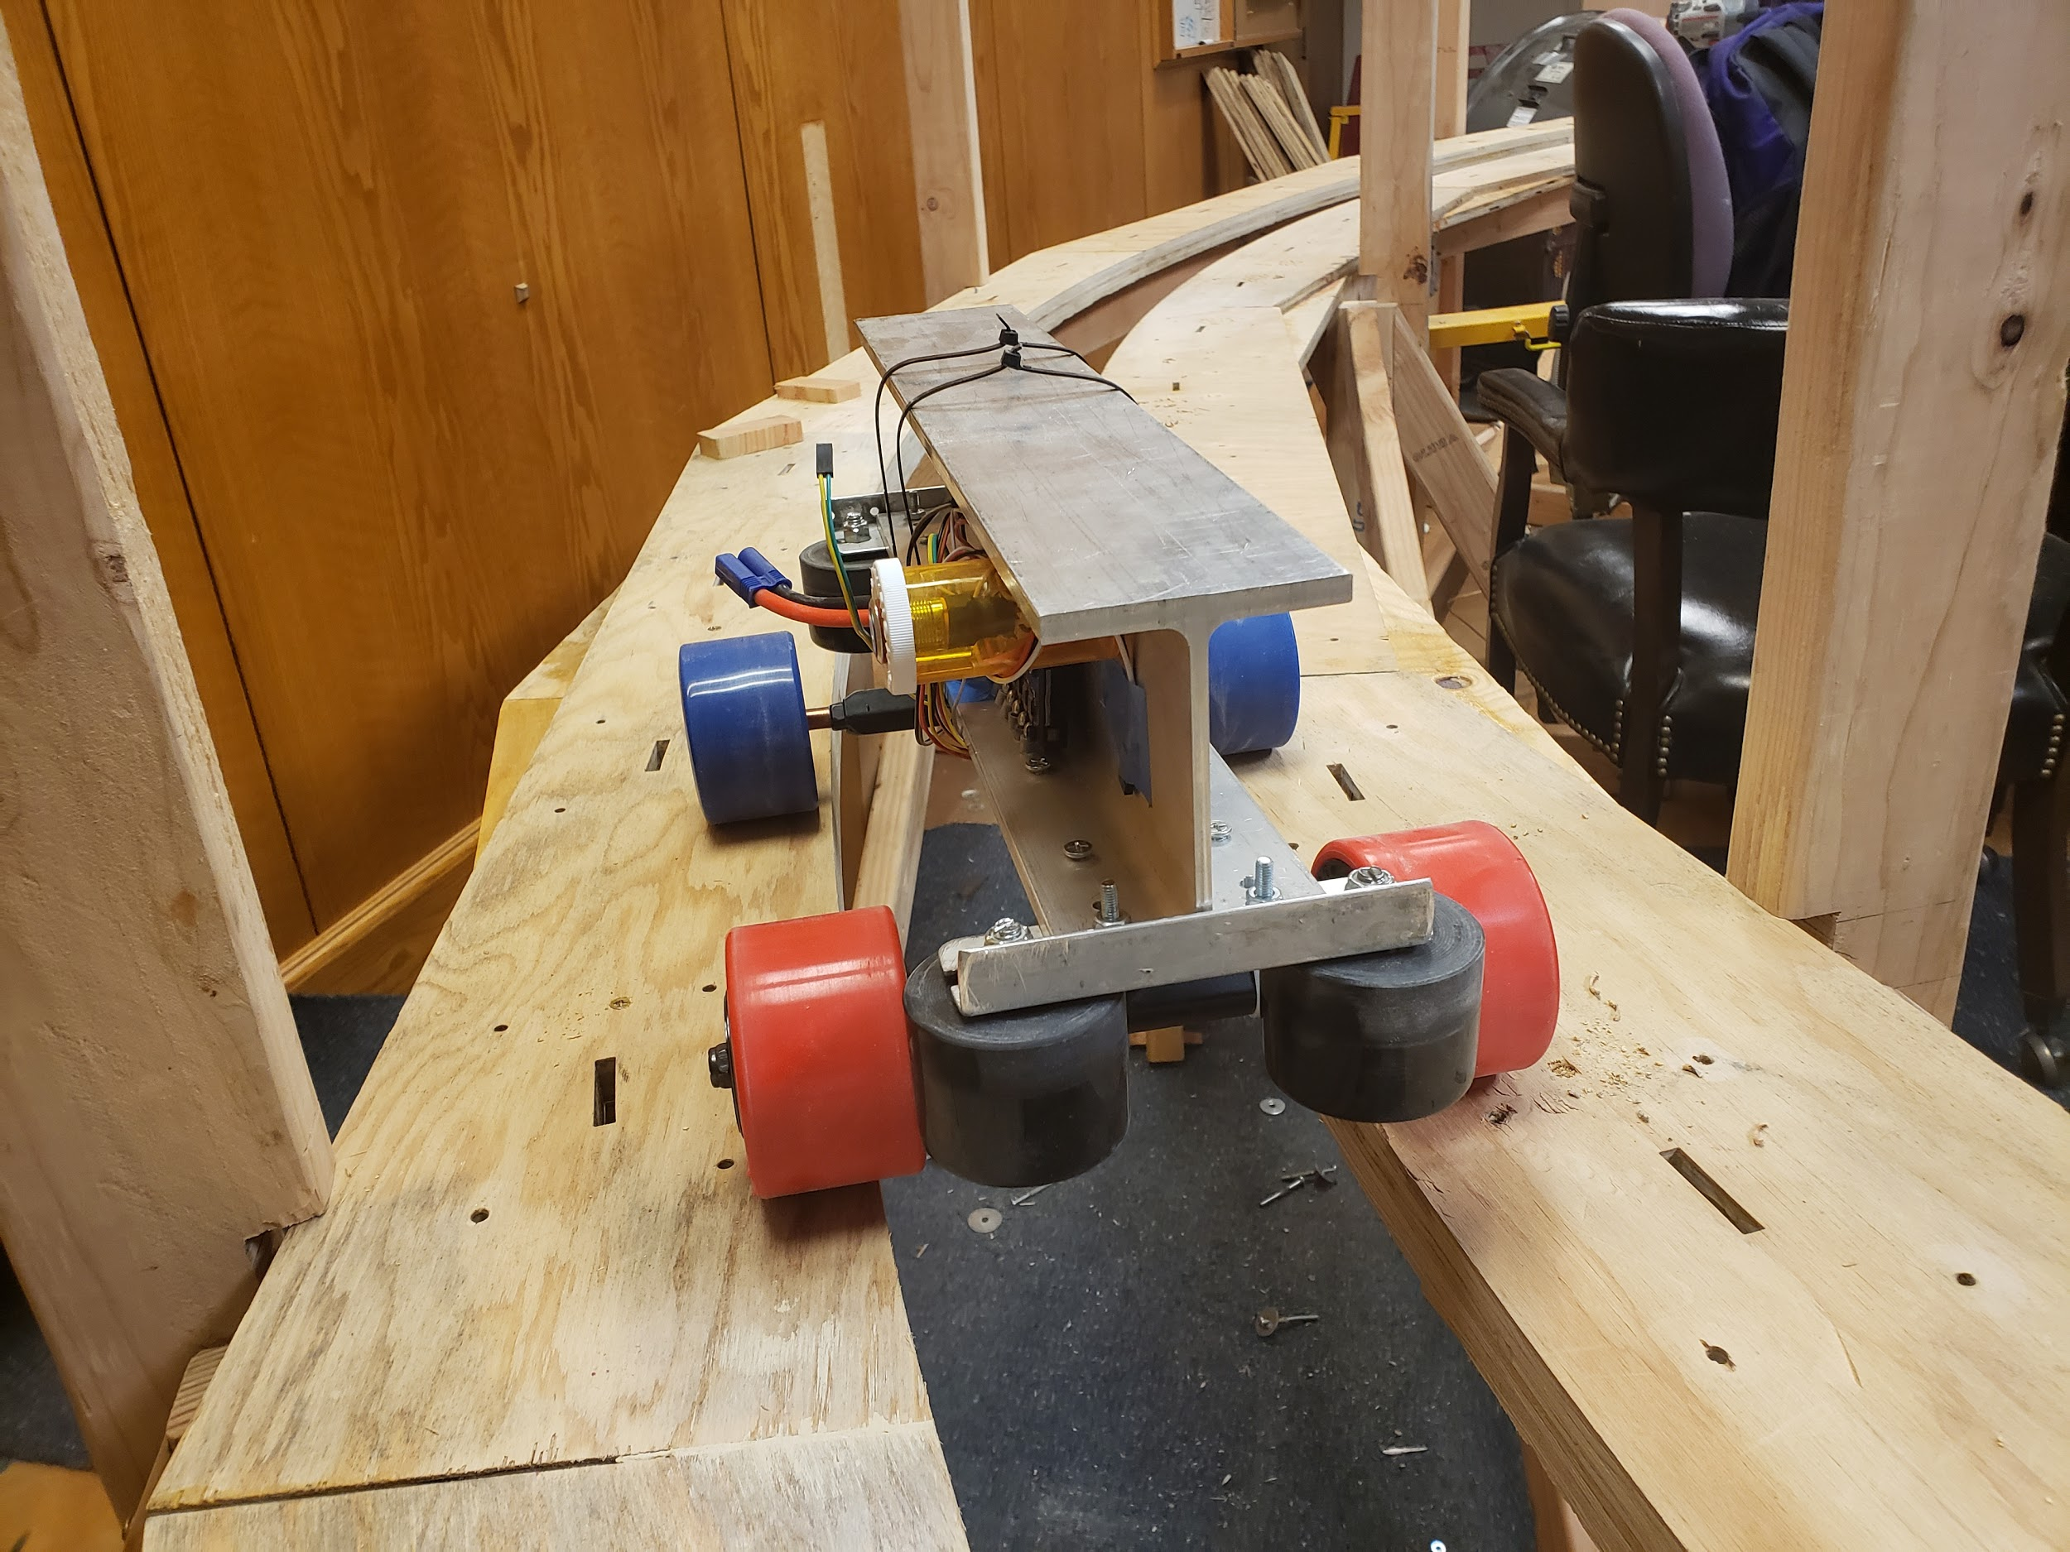
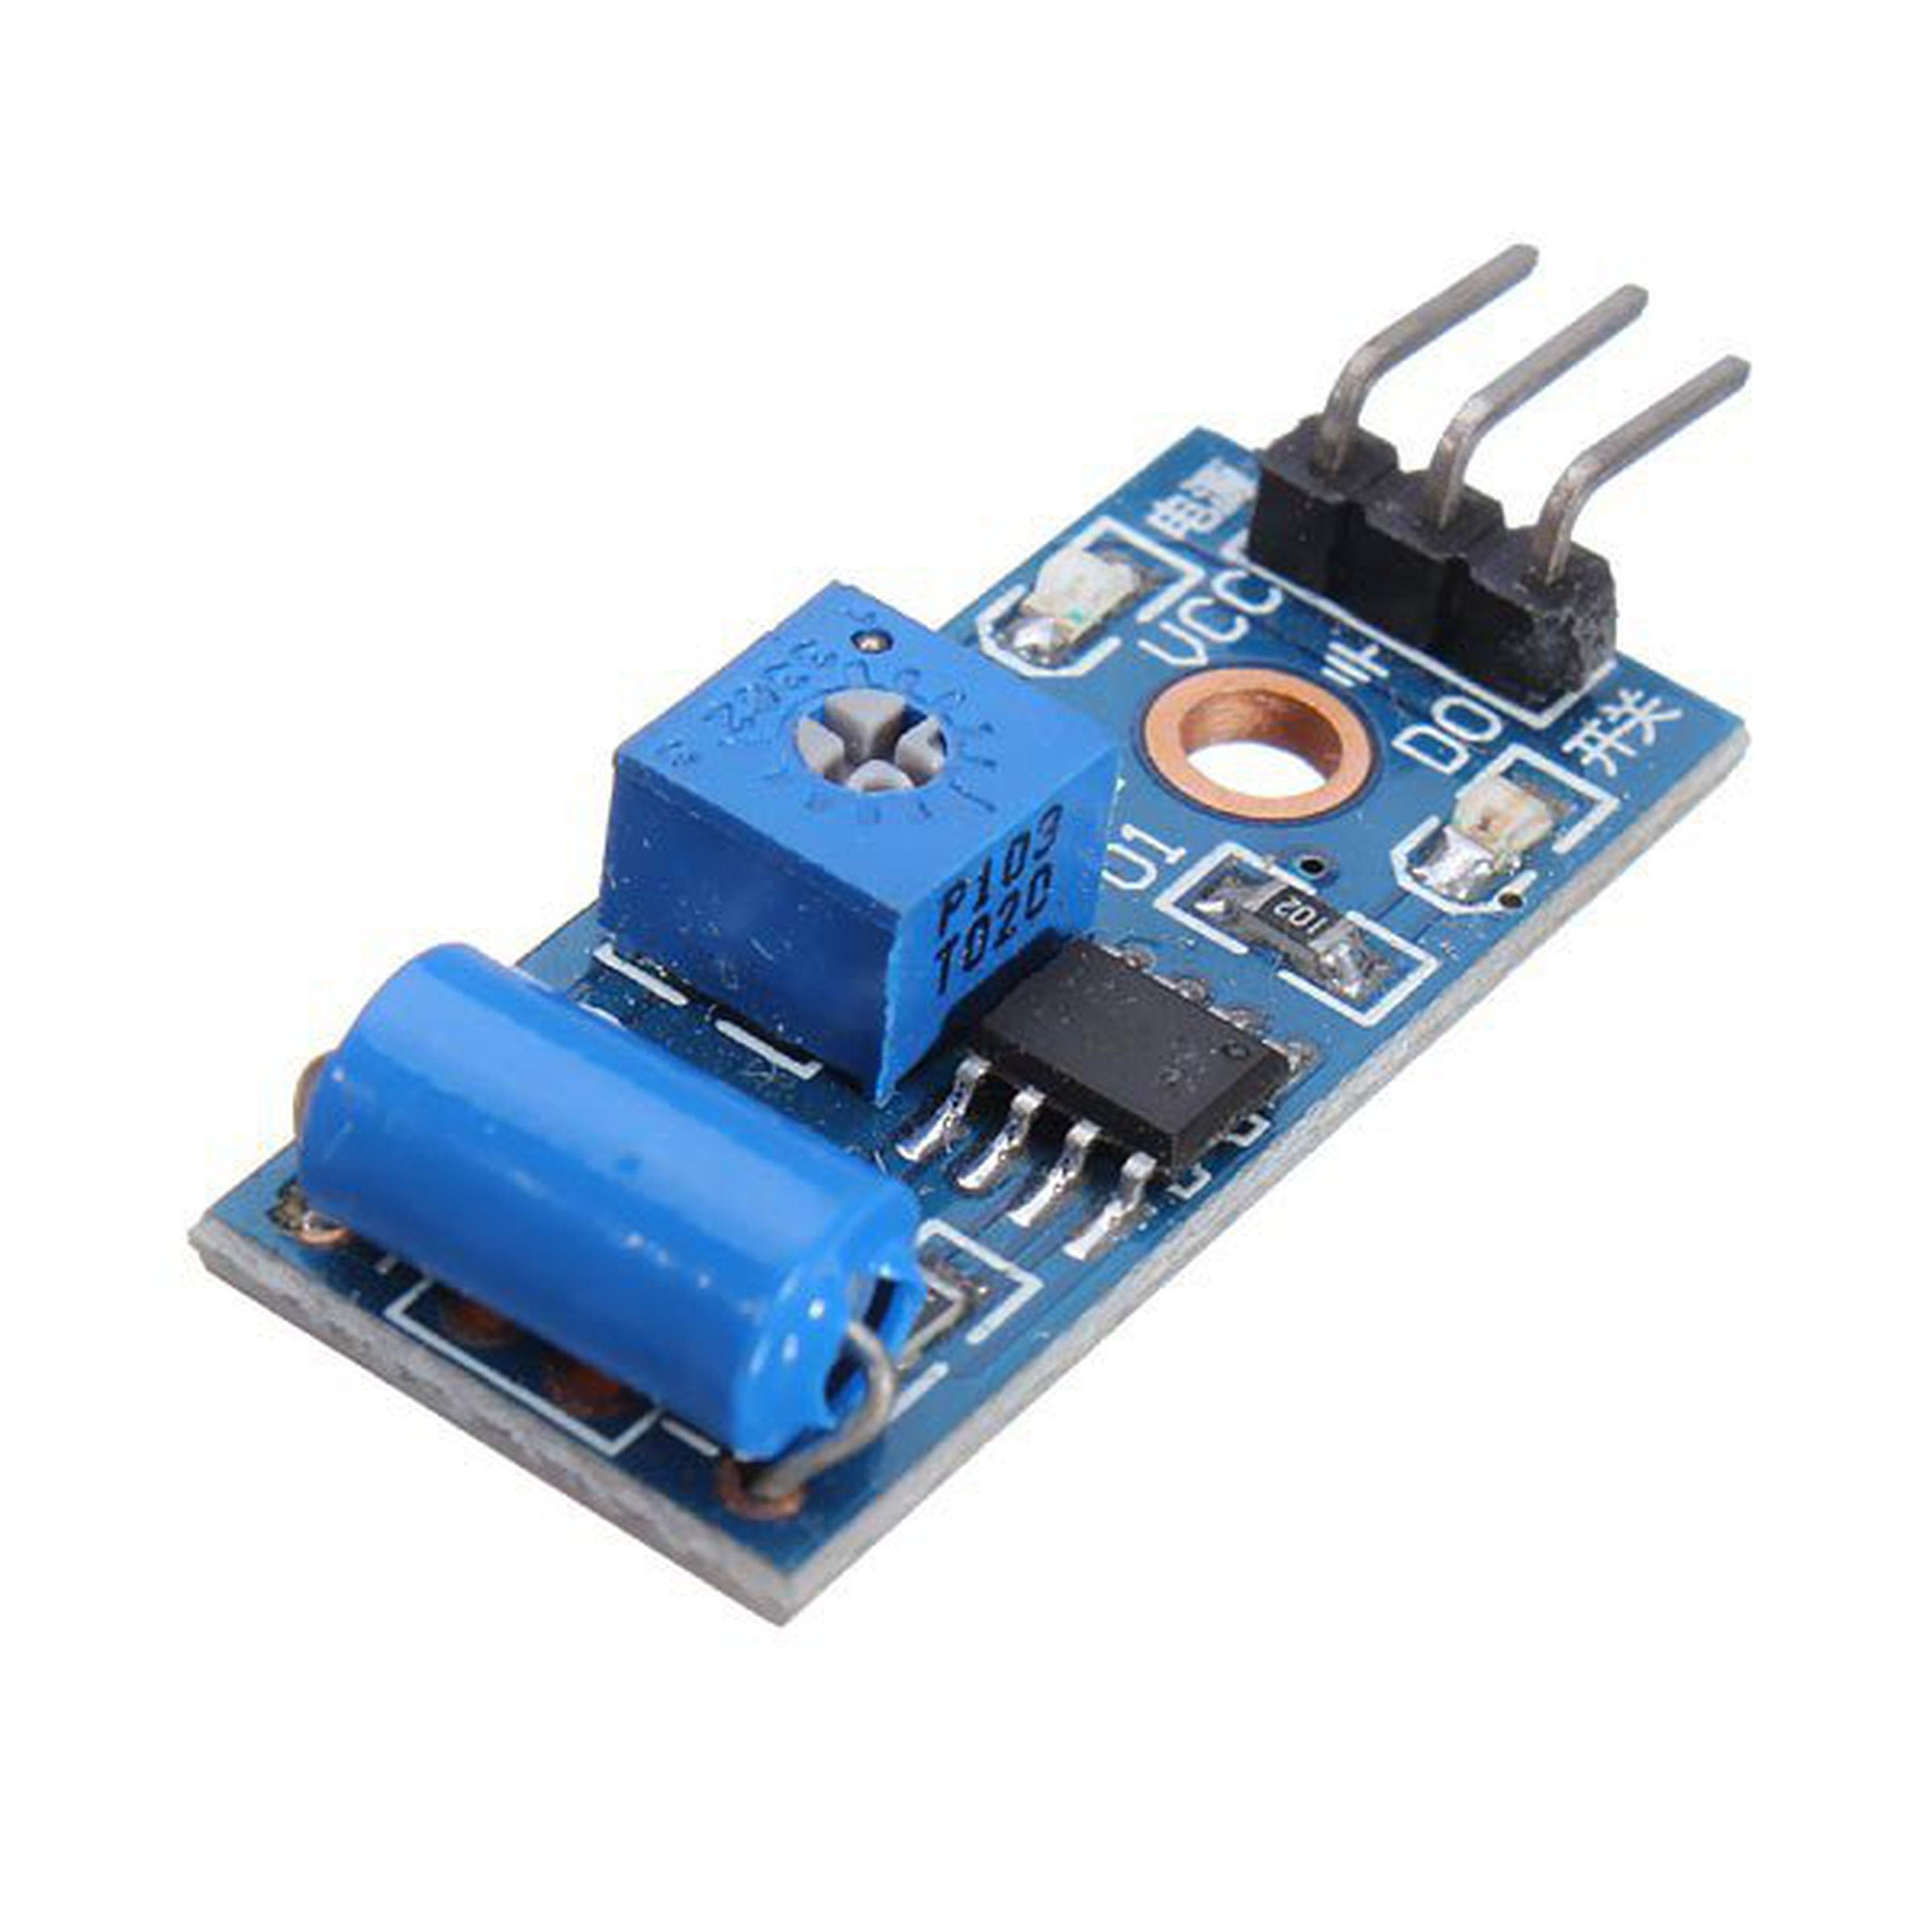
The chassis team must place sensors on the bogie and develop the appropriate code

Slide 28
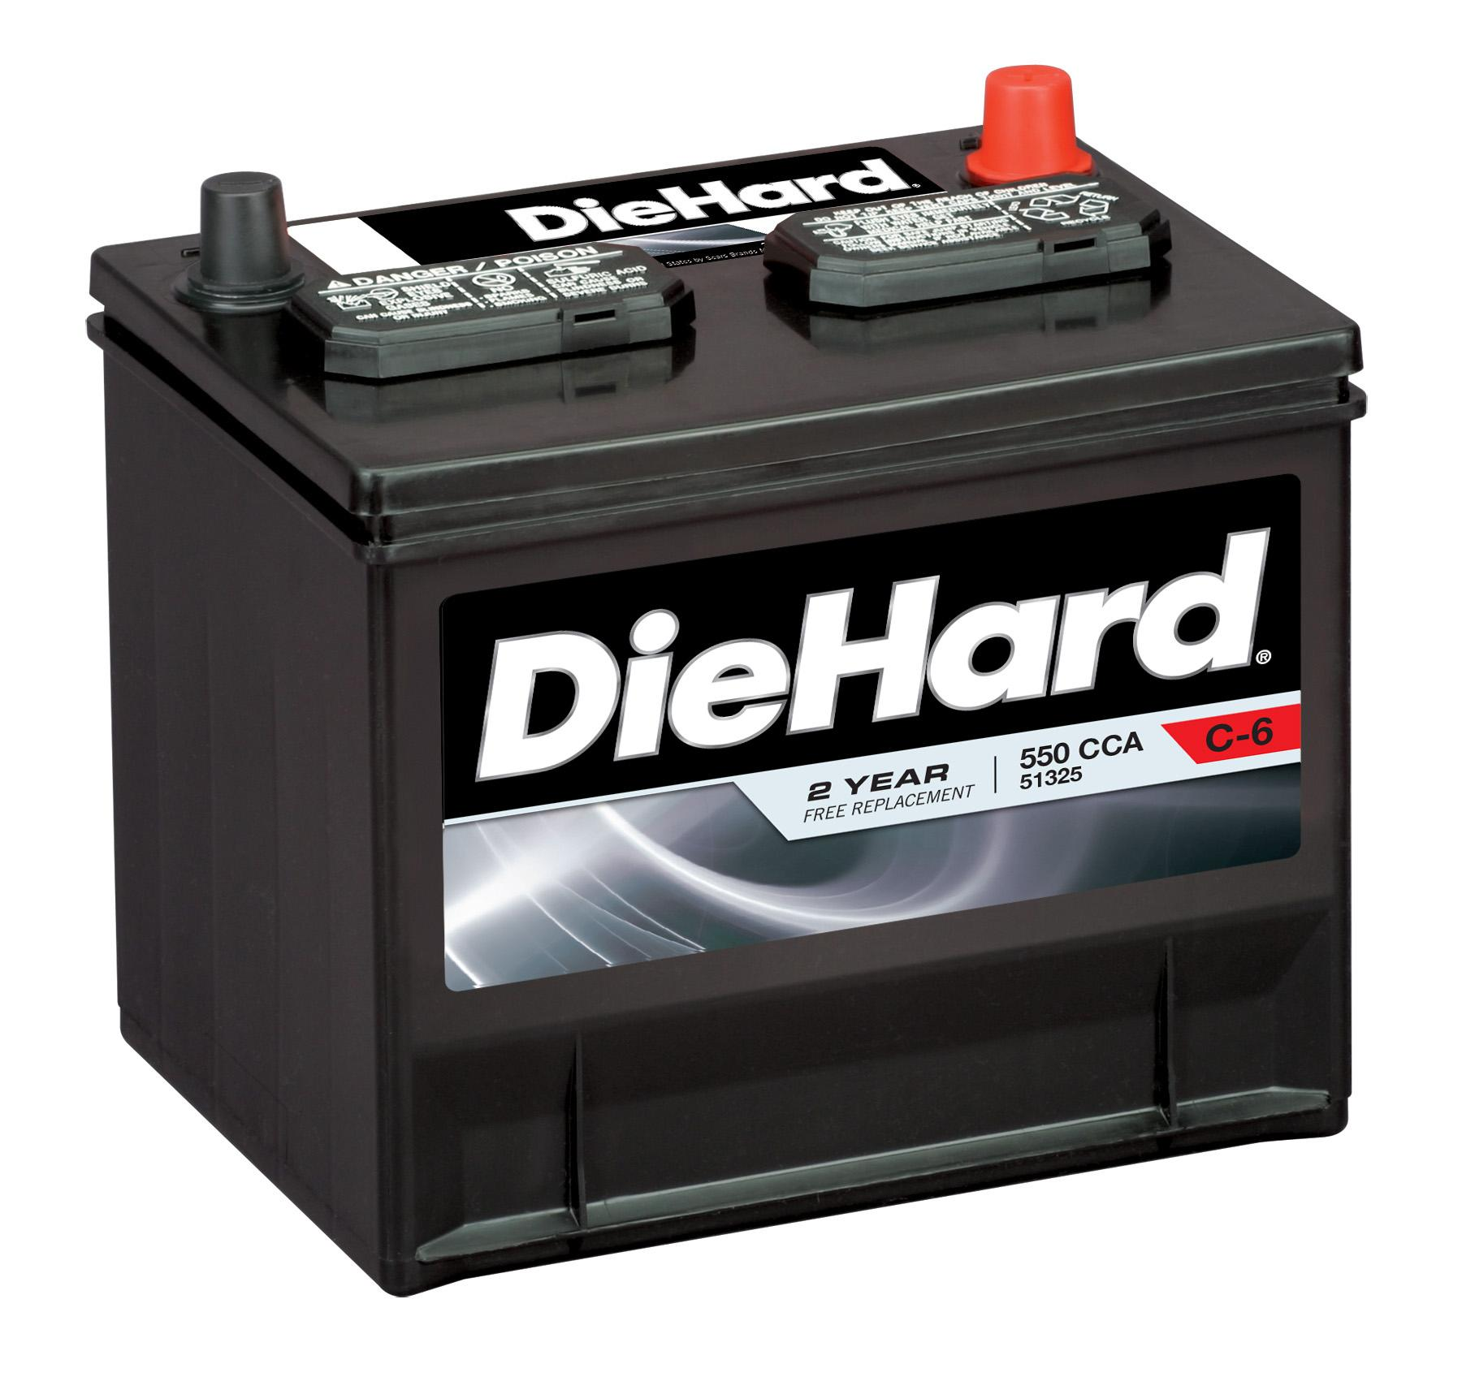
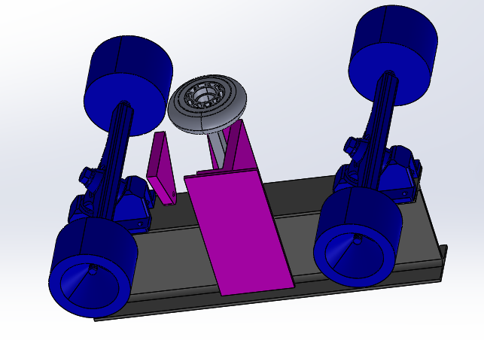
The bogie chassis team will also determine how to power the bogie and its systems

Slide 29
Documentation is essential to this task, and the team members will be graded on it.

Slide 30
Come and Join our Team!

Slide 31
Switch Arm Design

Slide 32
The primary objective of the switch arm team is to design and manufacture a mechanism that will switch at an intersection of the track safely and reliably

Slide 33
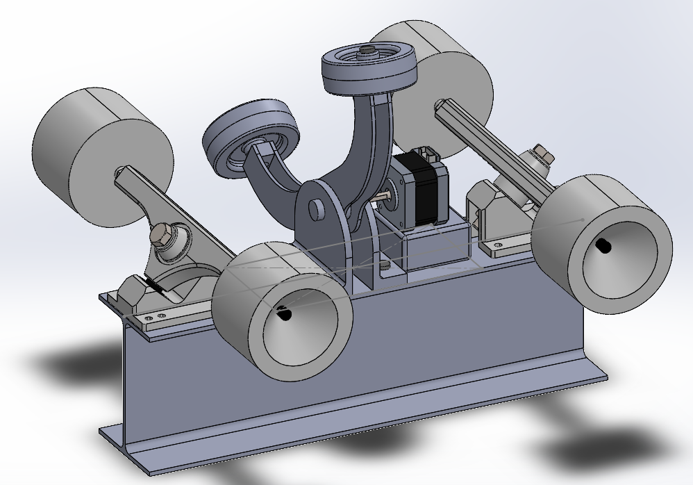
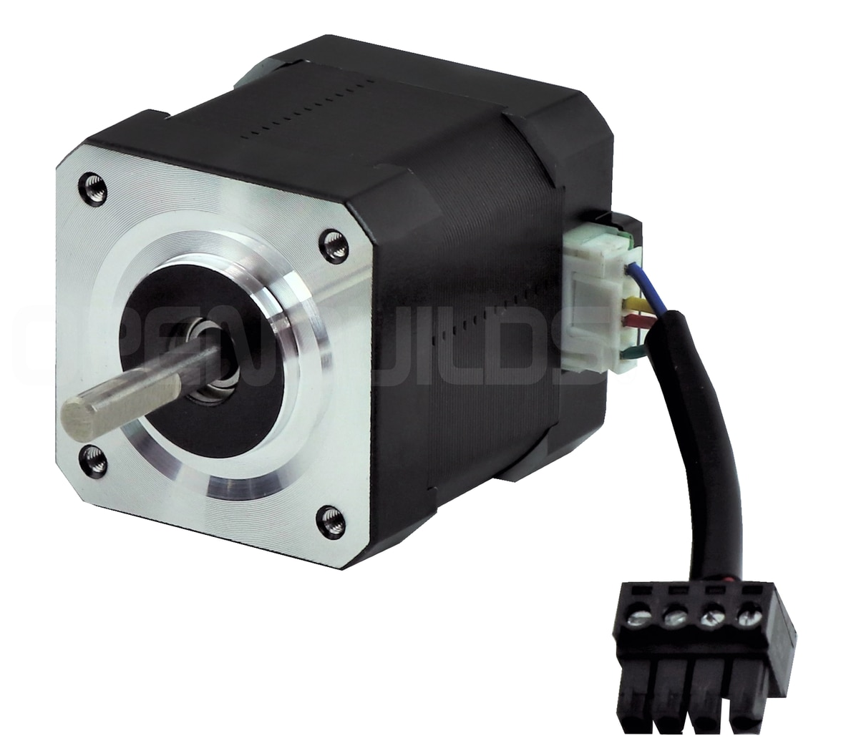
The incorporation of mechatronics and mechanical design concentrations is needed to complete this project
Notes:
Insert CAD of bogie here as example of mechanical design

Slide 34
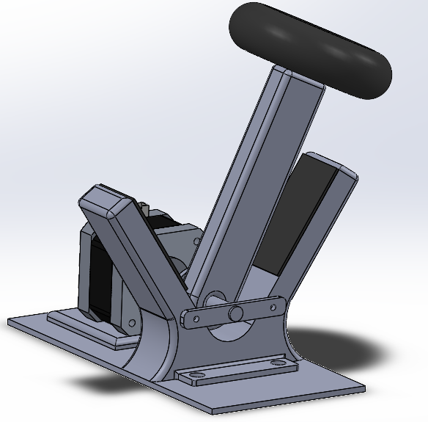
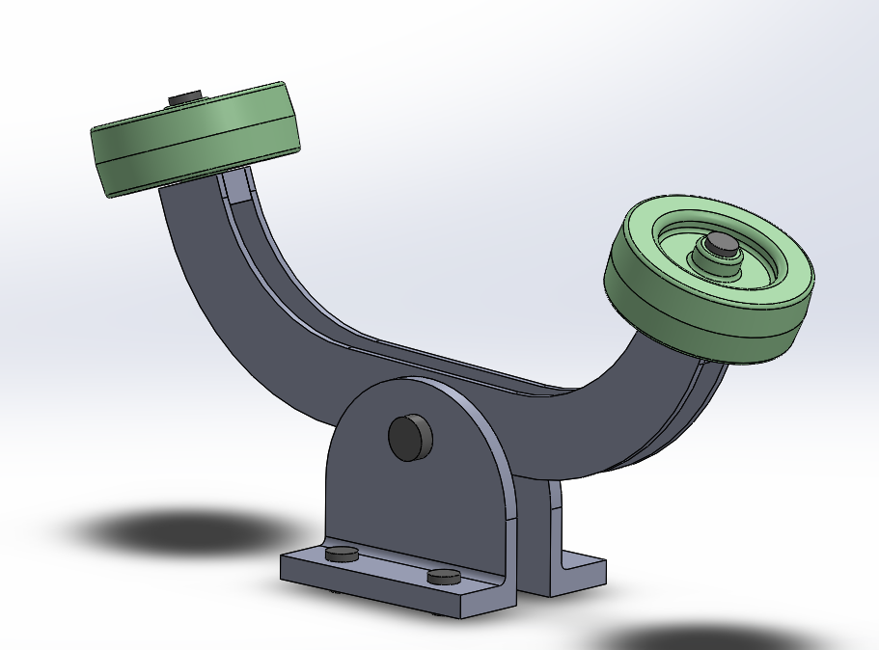
The design of the switching mechanism has to fulfill the listed constraints depending on the intended chassis assembly

Slide 35
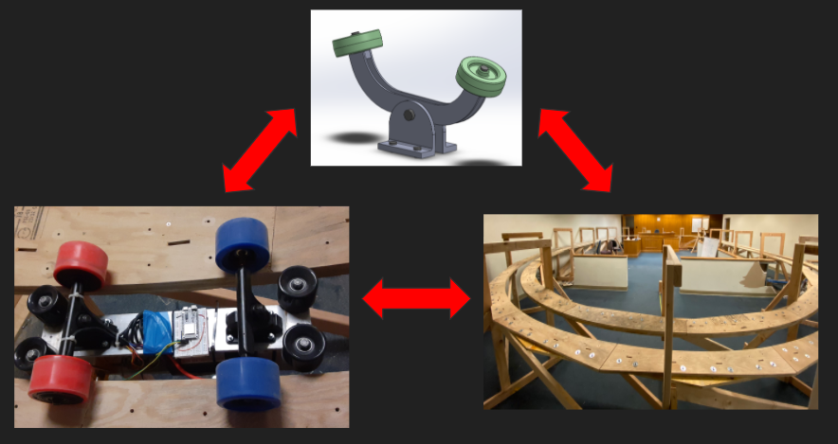
The collaboration between all teams is integral in manufacturing the ideal switching mechanism for each respective group

Slide 36
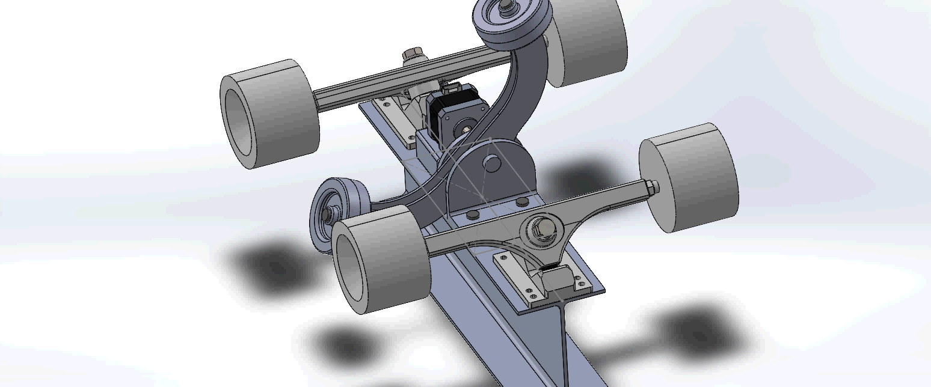
Showcase of Potential Switch Arm Designs

Slide 37
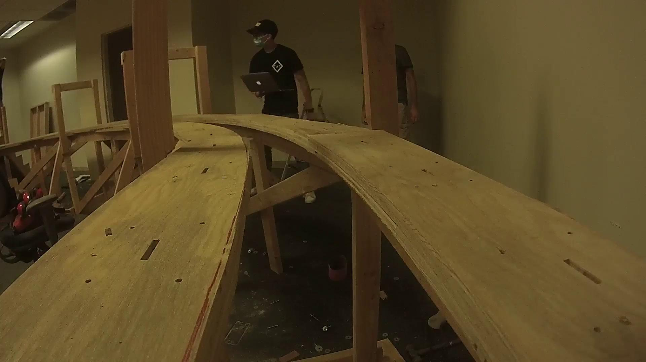
POV of the Pod at top speed

Slide 38
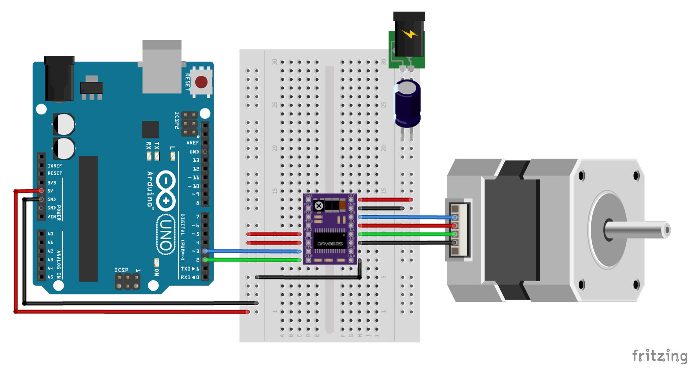
If you join this team, you will gain experience in:
Notes:
Fade in slides transition

Slide 39
Come and Join our Team!

