Slide 1
Civil Team - Summer 2016
August 10th , 2016
ALLAN OLIVEIRA
DAVI CERQUEIRA
EDUARDO ALPES
KARIMA LAGRAF
KELVIN ANDRADE
NAYARA SANTOS

Slide 2
AGENDA
Potential Routes
South Campus
Test Track Layout
Environmental Studies

Slide 3
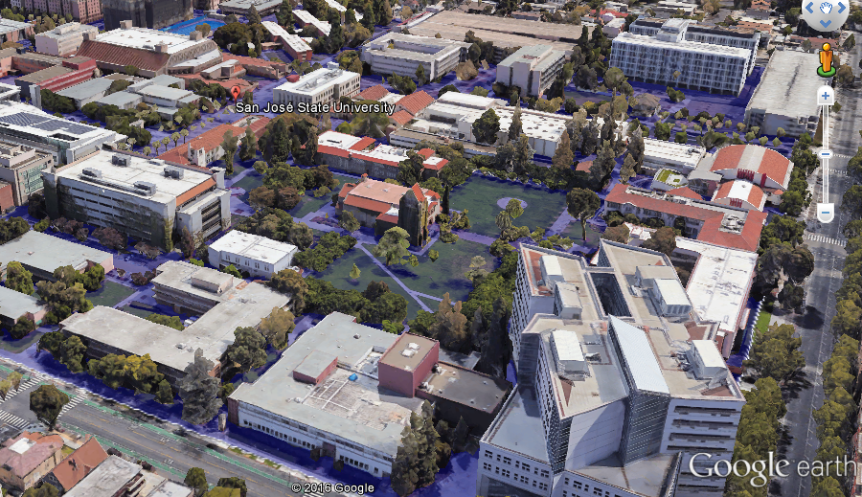
The goal for the first phase of the project is to link SJSU Campuses
Notes:
Coordenação de Aperfeiçoamento de Pessoal de Nível Superior (CAPES)

Slide 4
The goal for the first phase of the project is to link SJSU Campuses

Slide 5
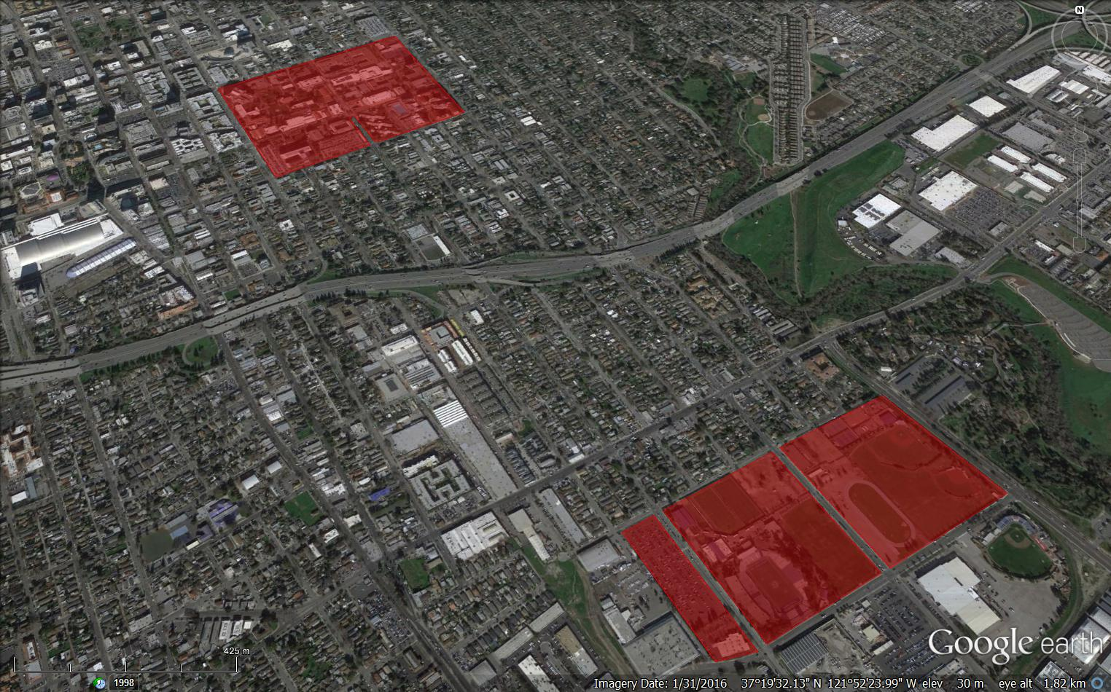
Highway I-280 is the most critical point to overcome
Main Campus
South Campus

Slide 6
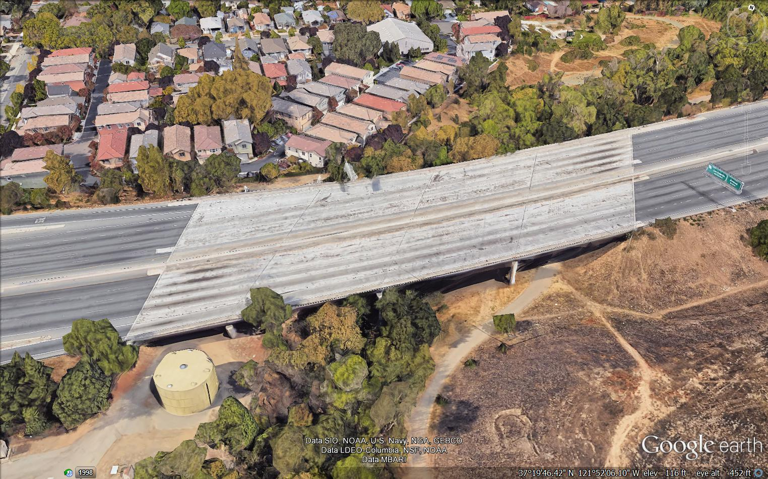
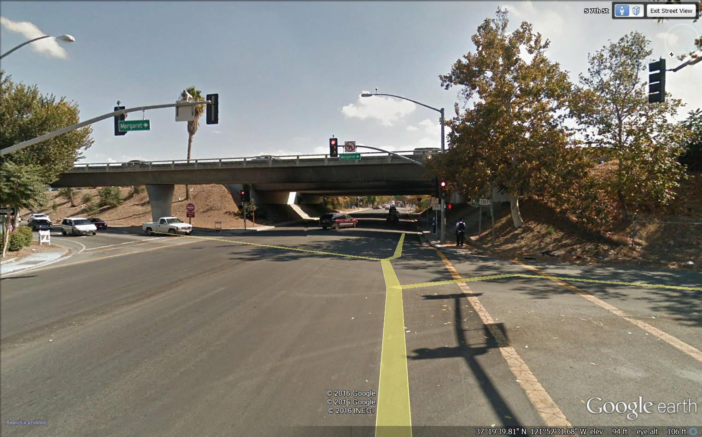
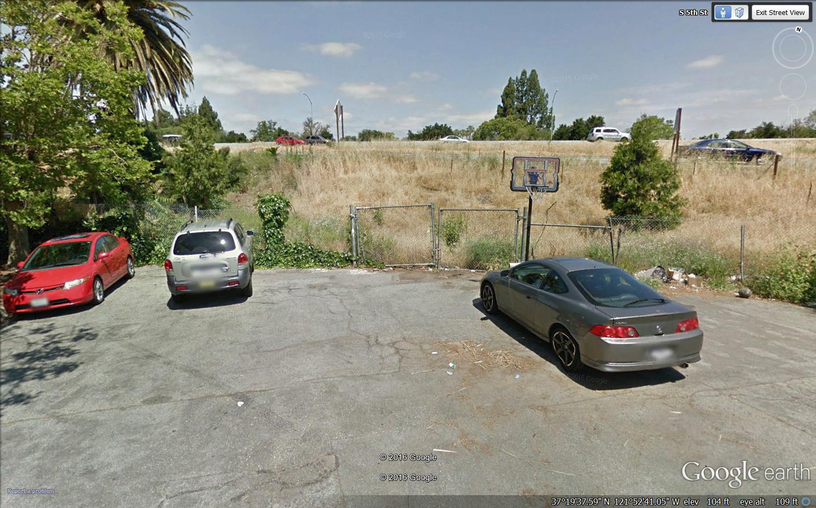
Highway I-280 is the most critical point to overcome
Main Campus
South Campus

Slide 7
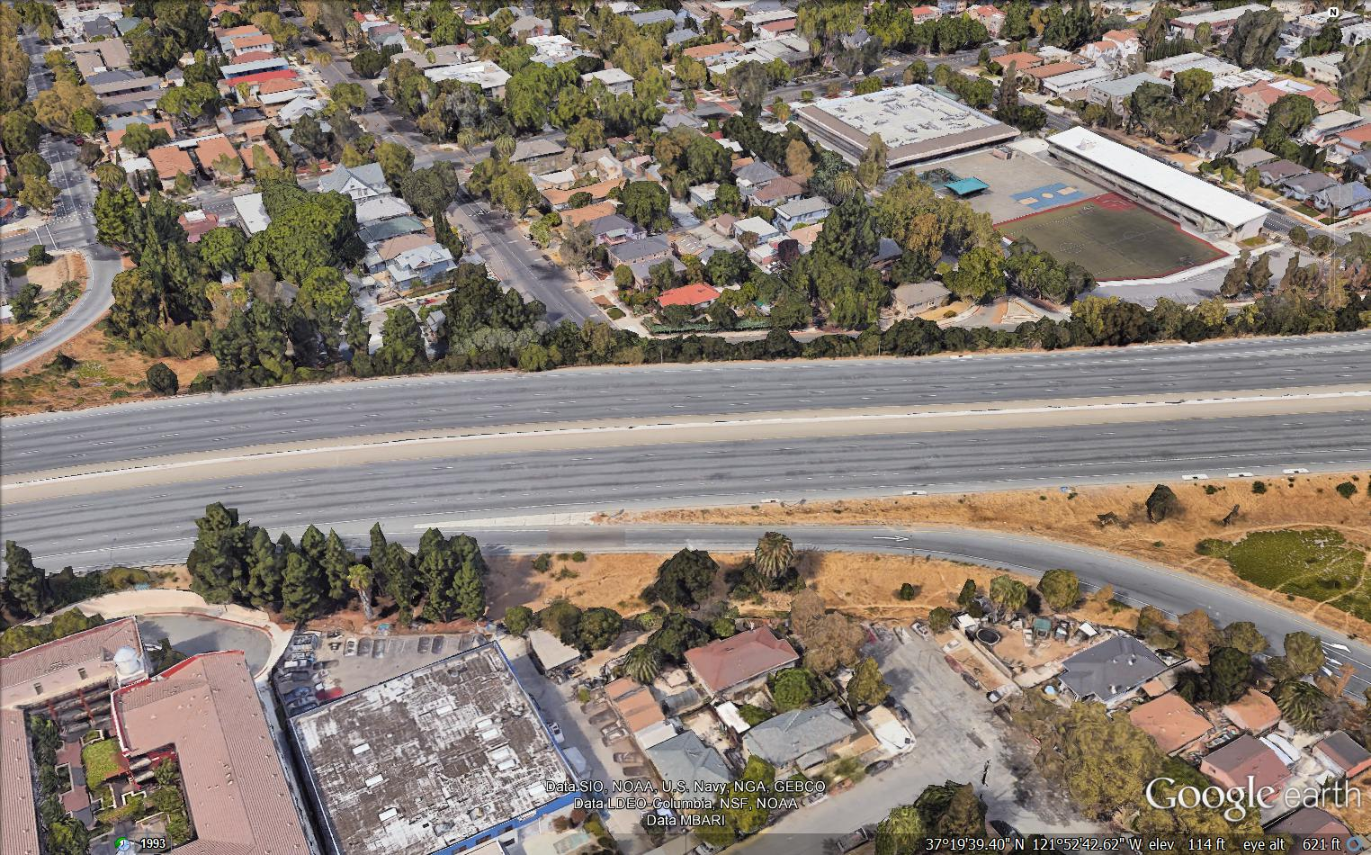
5th Street is unviable.

Slide 8
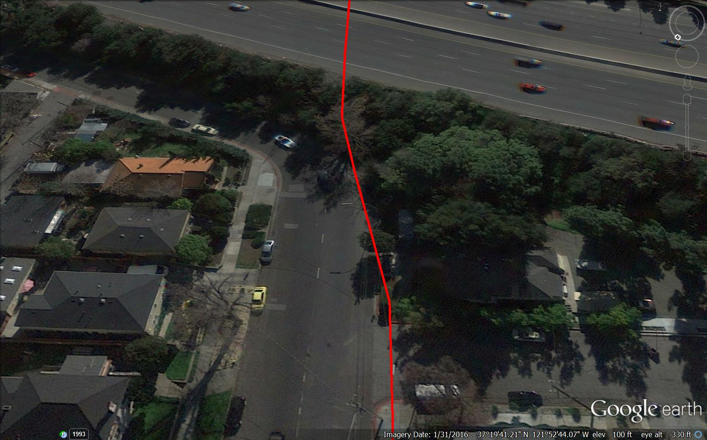
5th Street Problem.
23 meters!

Slide 9
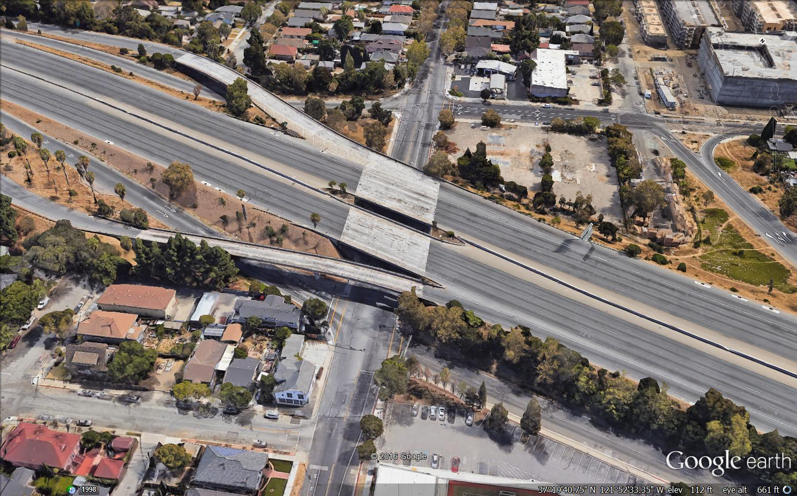
7th Street is unviable.

Slide 10
7th Street Problem.

Slide 11
River Path is Unviable.

Slide 12
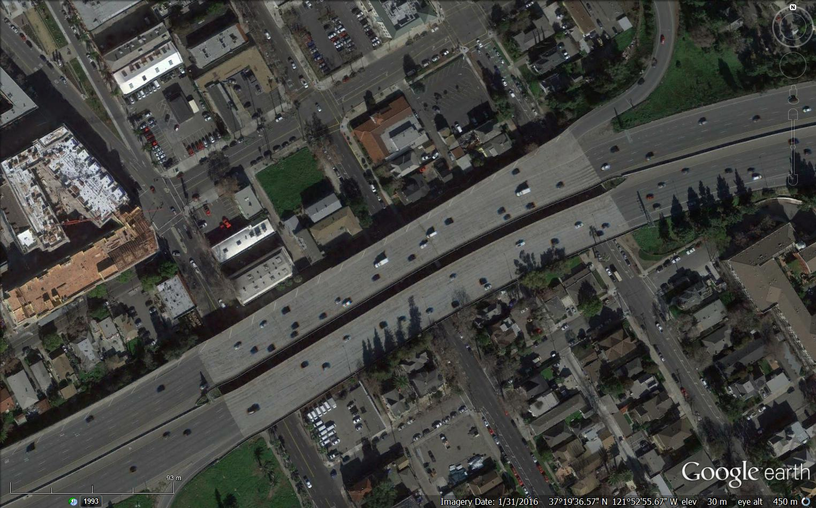
2nd Street Alleys are Viable
BUT DISTURB THE POPULATION IN THOSE AREAS!

Slide 13
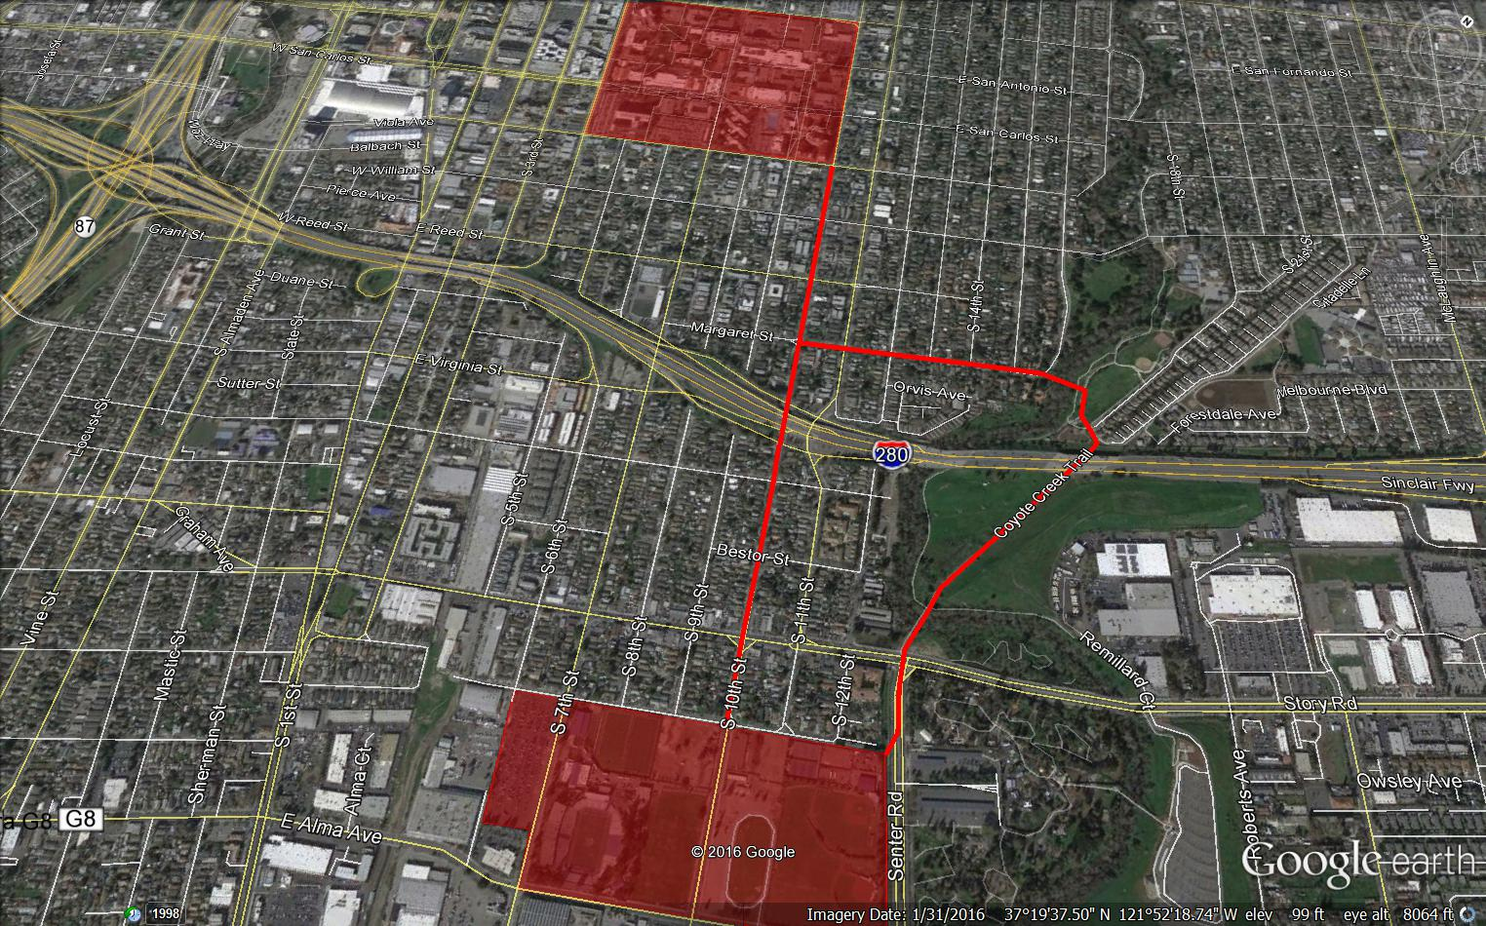
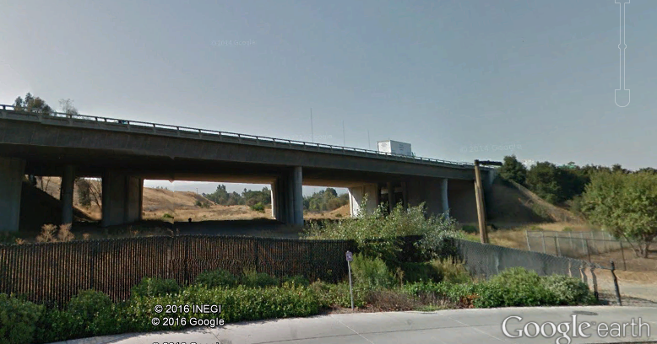
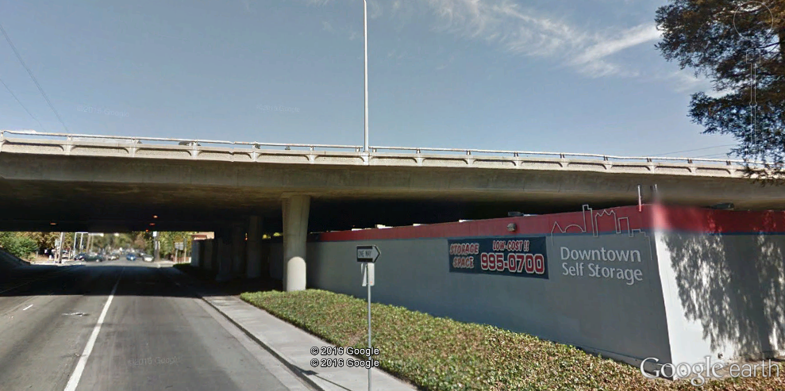
The most convenient route uses 10th Street and Coyote Creek Trail

Slide 15
Every project has its problems and challenges.

Slide 16
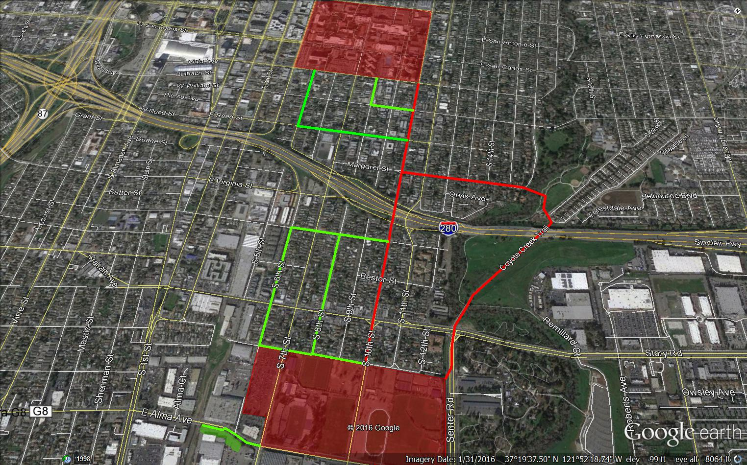
The routes can be expanded to reach more people

Slide 17
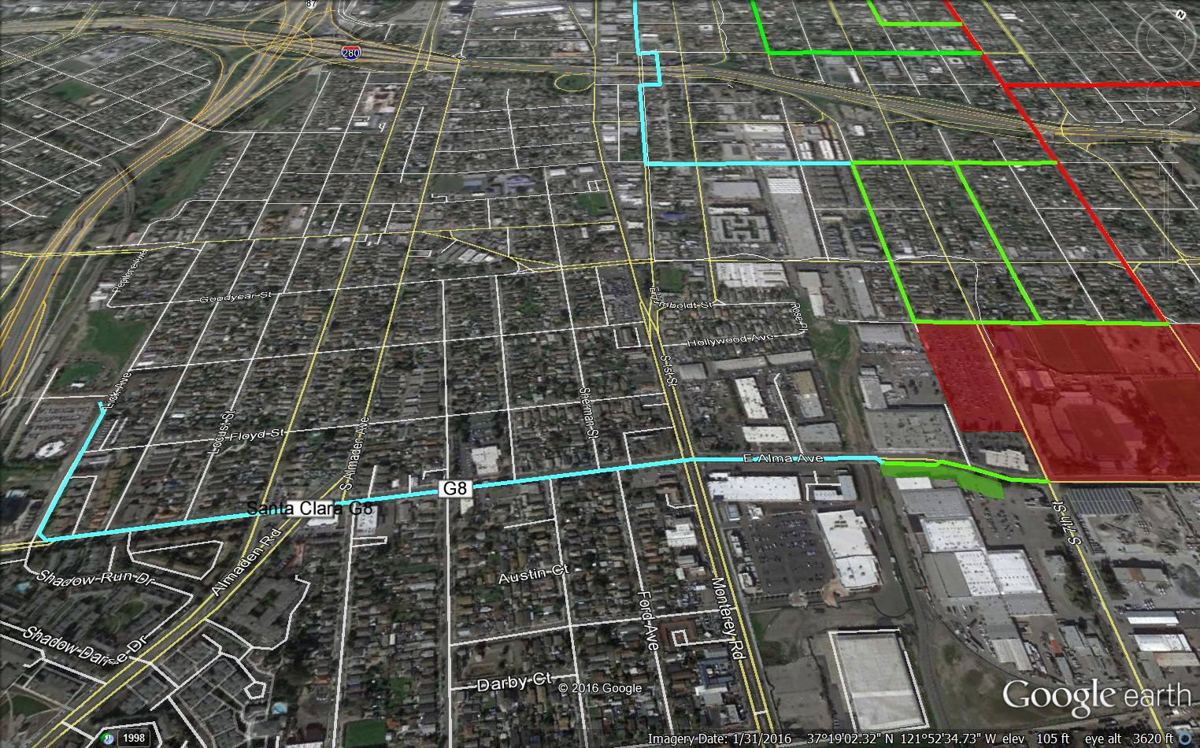
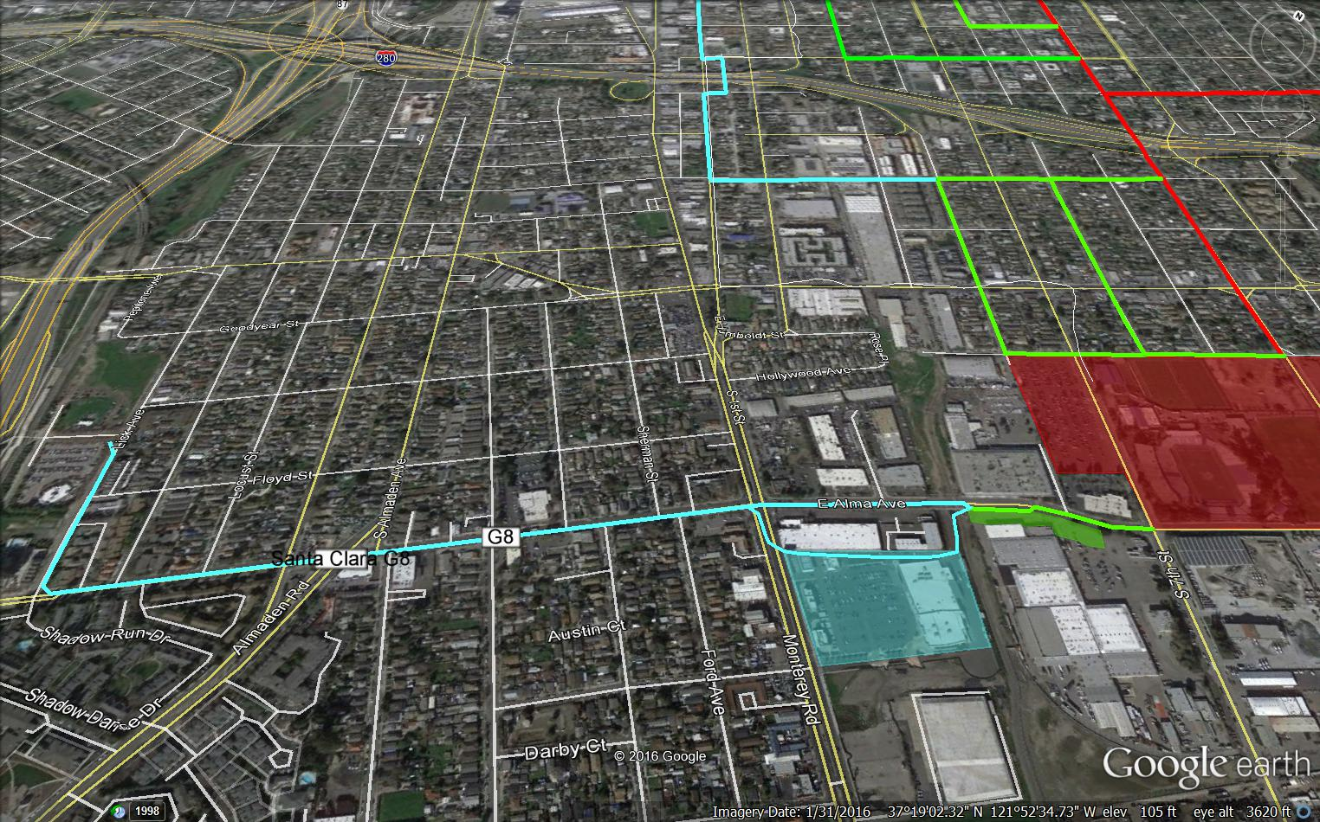
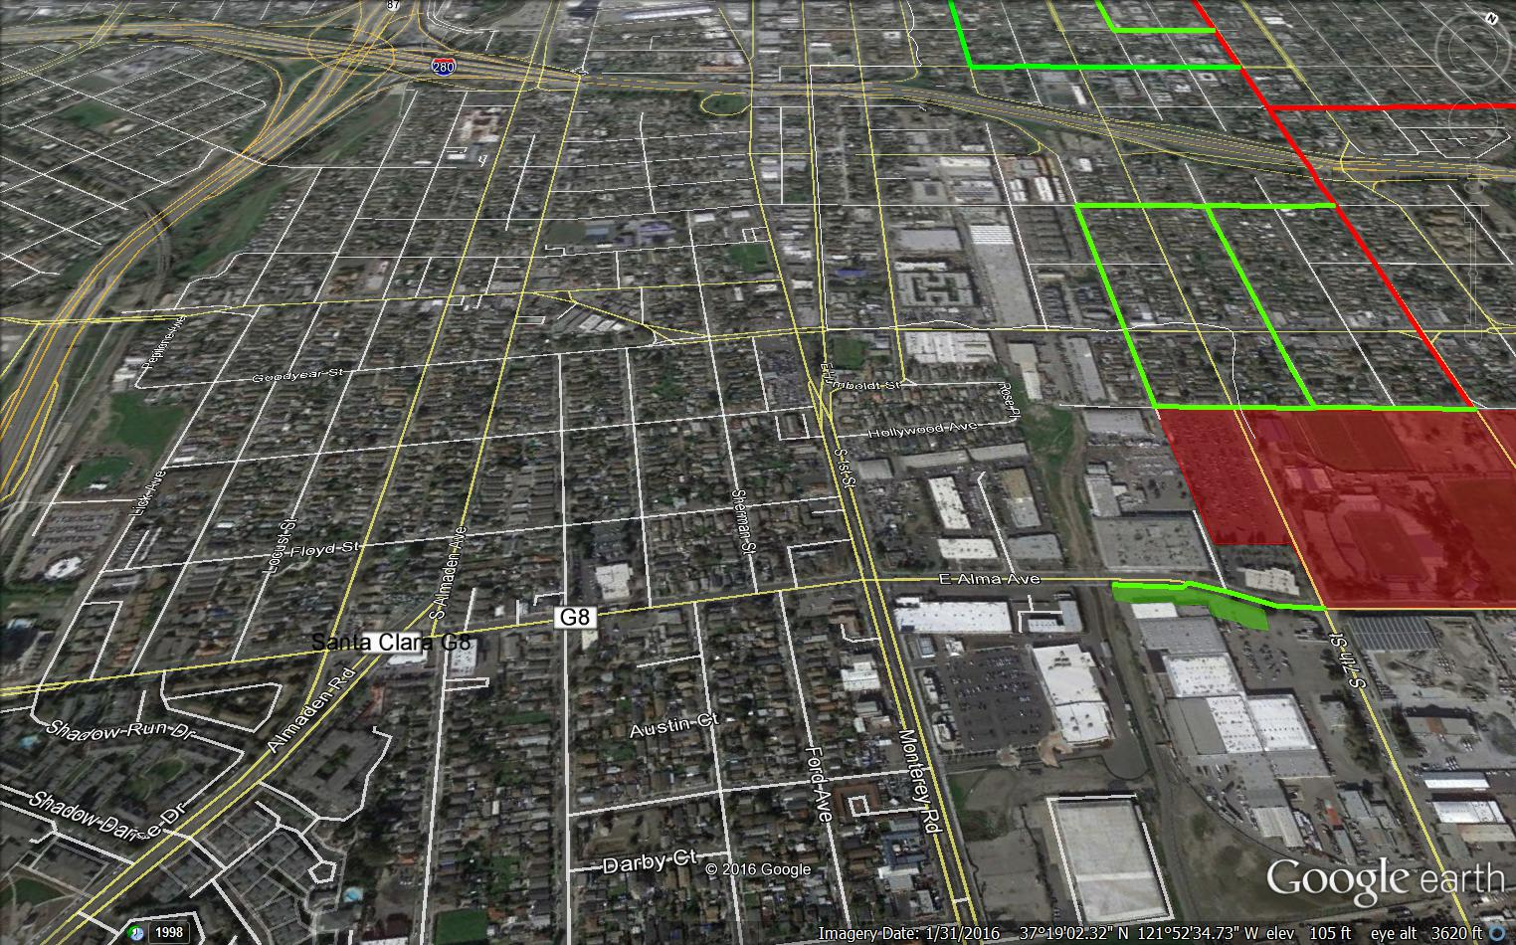
Reaching points of interest

Slide 18
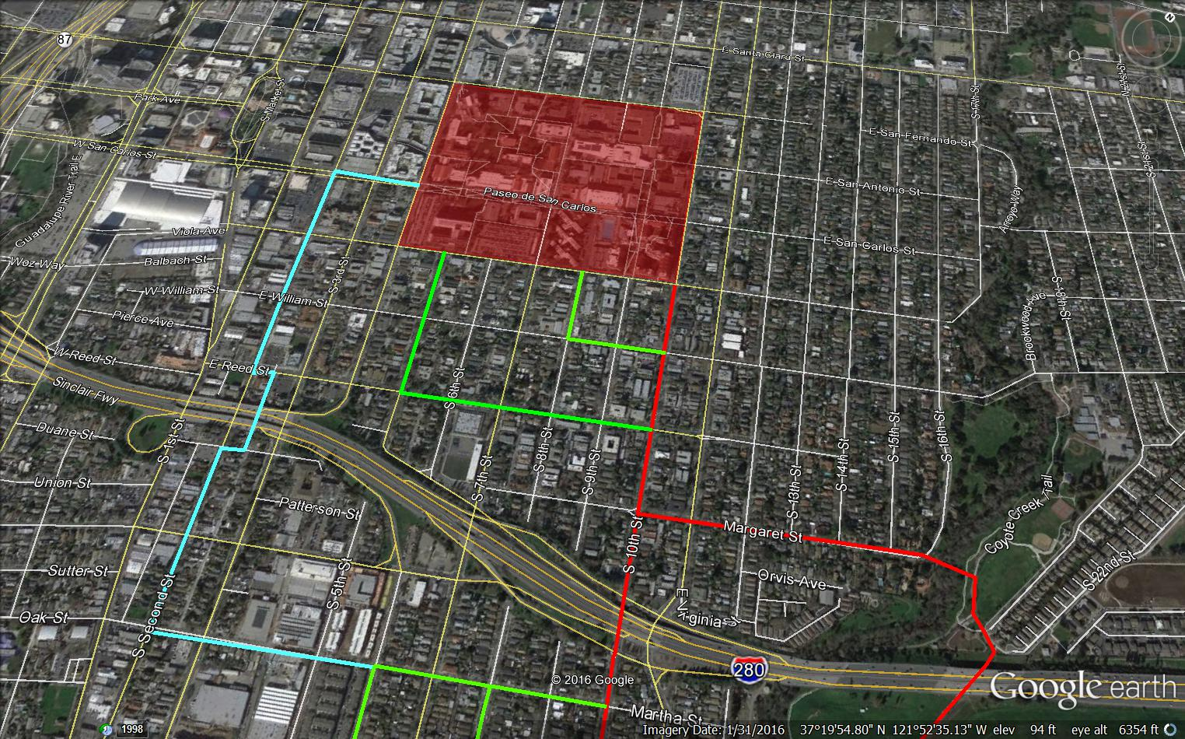
Reaching points of interest

Slide 19
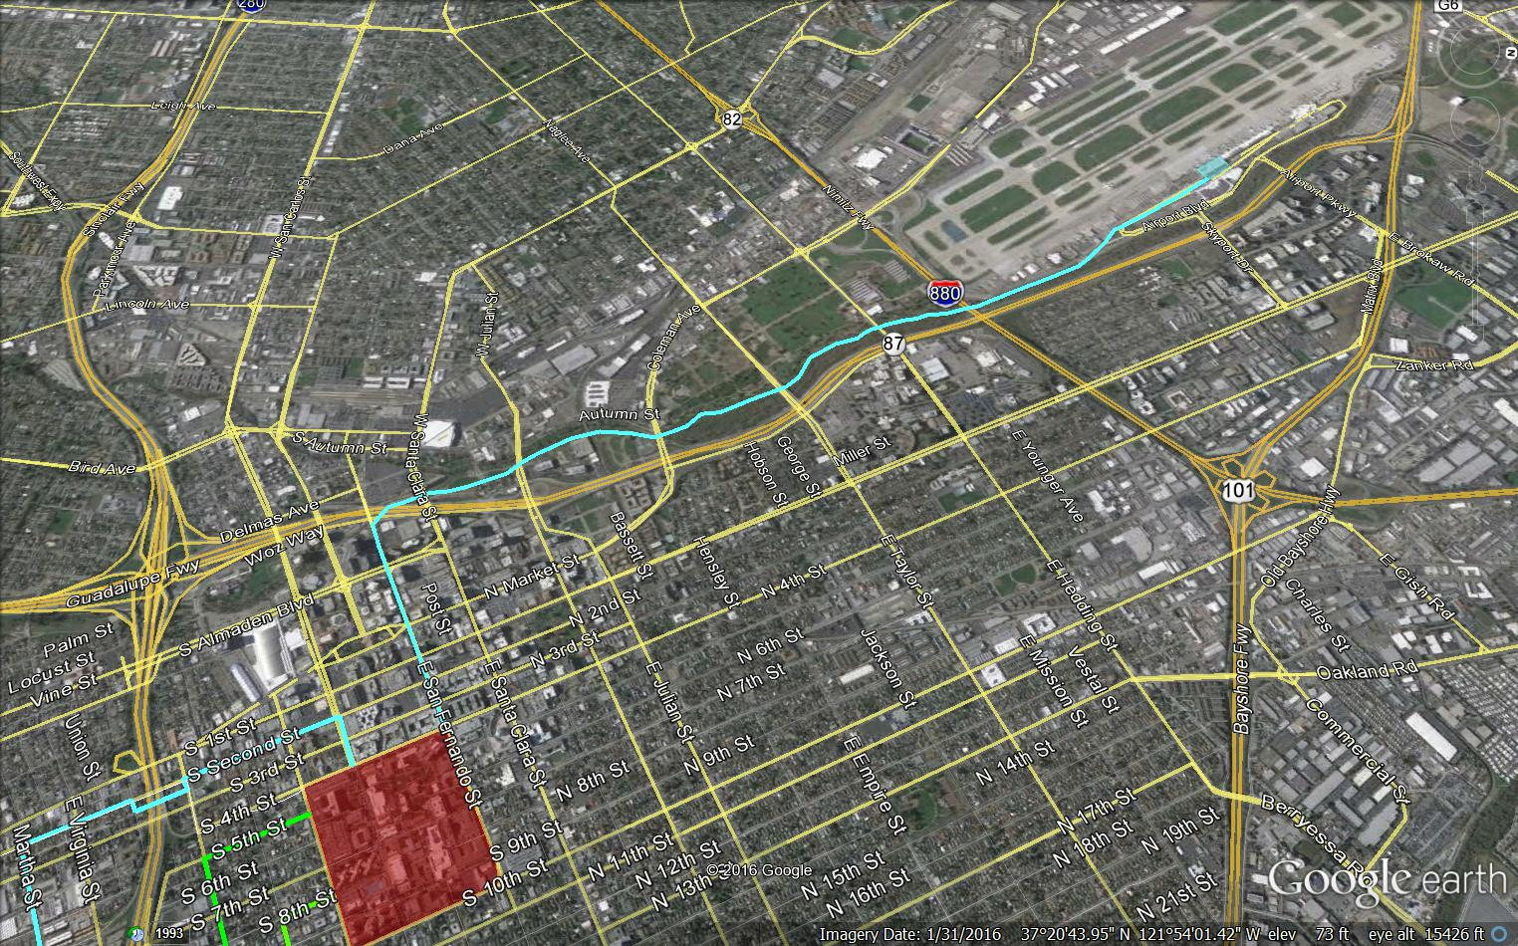
Reaching points of interest

Slide 20
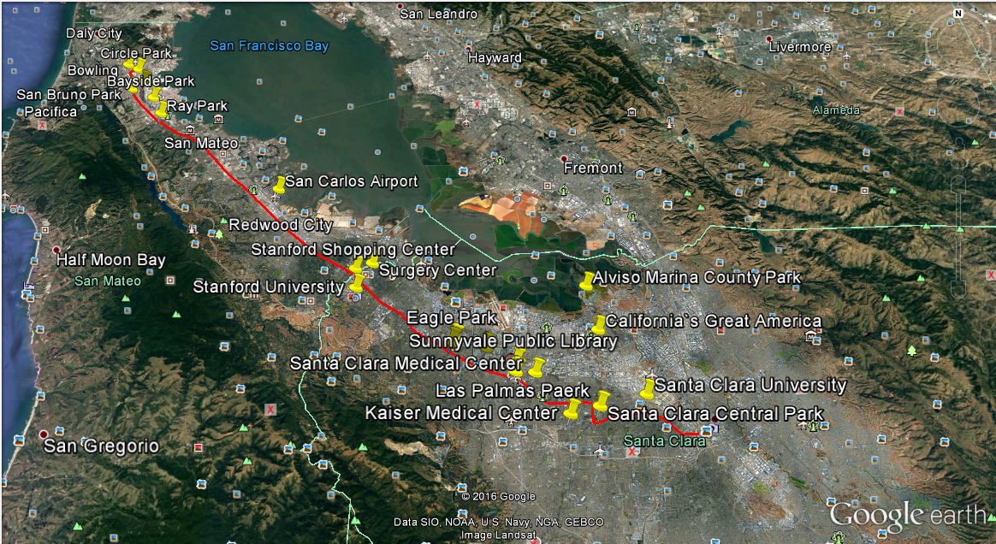
Identify the areas of interest
Search for the most convenient paths

Slide 21
AGENDA
Potential Routes
South Campus
Test Track Layout
Environmental Studies

Slide 22
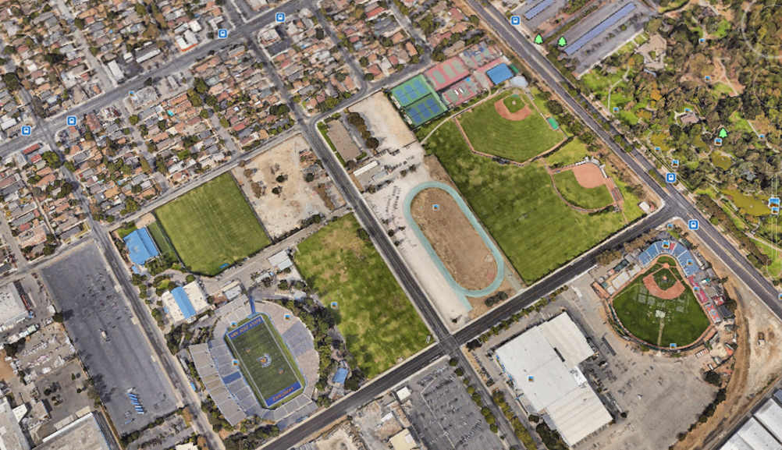
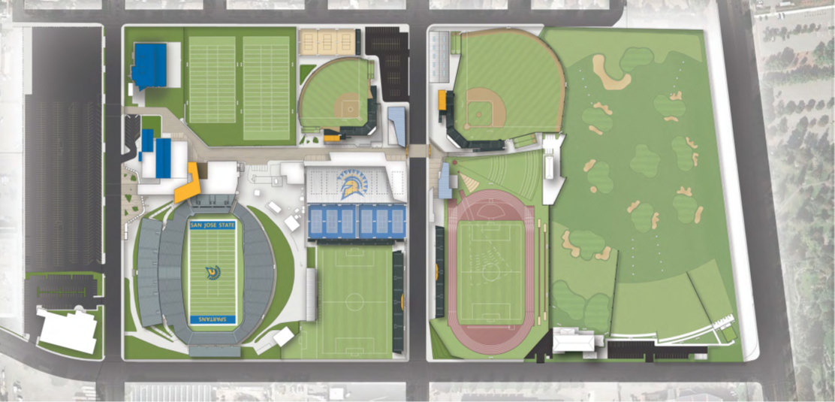
South Campus is a Sports Facility
Game Days
Stations
Notes:
The biggest demand would be during game days.
The main concern about the south campus was where to place the stations;

Slide 23
Pedestrian flow is a relevant aspect

Slide 24
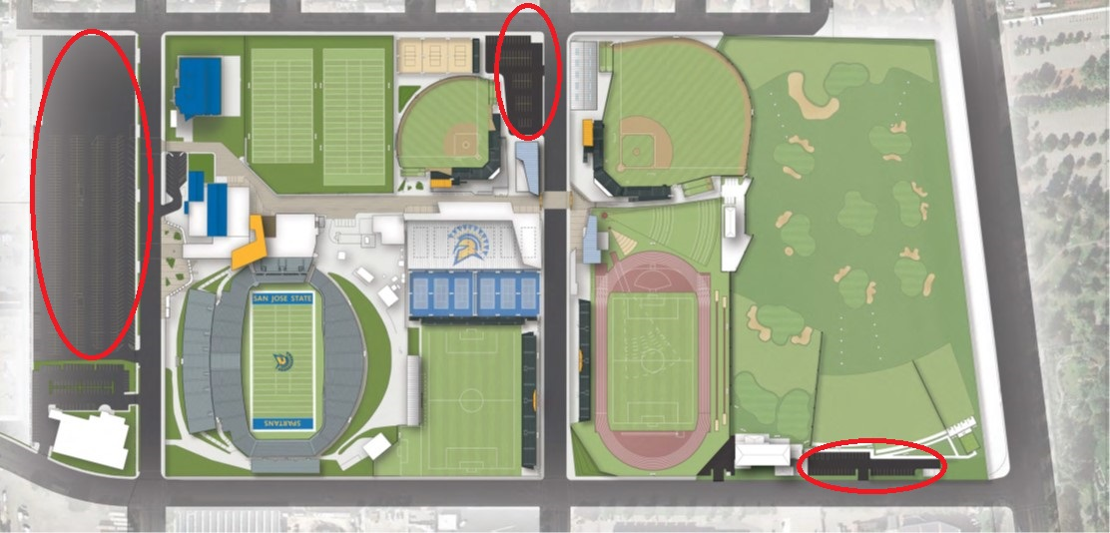
The best solution is to use parking lots areas to put stations
Notes:
Build three stations using three available parking lots in South Campus;
The stations will also attend the Park near the Campus;
Using the parking lots is the main advantage for this situation;

Slide 25
AGENDA
Potential Routes
South Campus
Test Track Layout
Environmental Studies

Slide 26
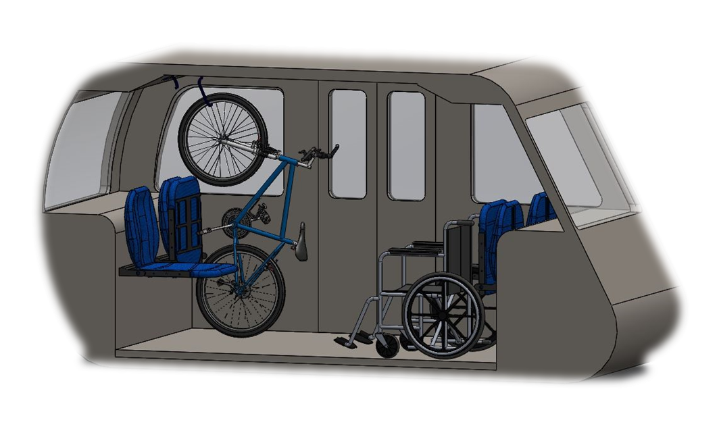
We need to test our model

Slide 27
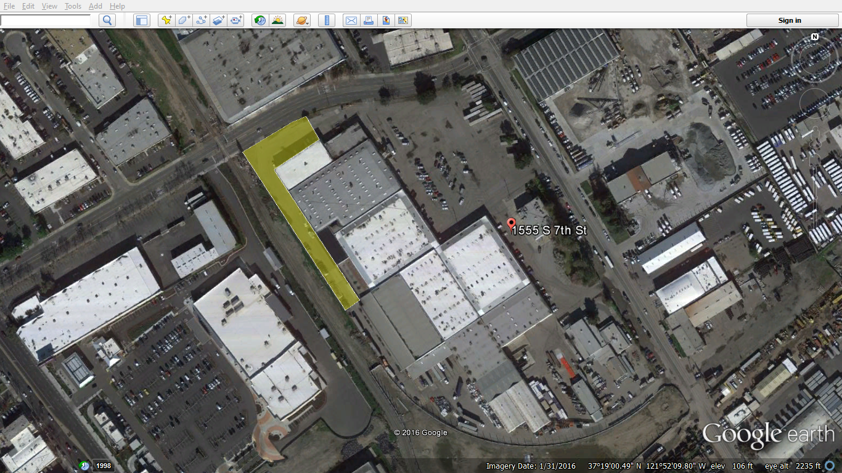
We had three goals for 1555 South 7th street
Full Scale Test Track
Half Scale Test Track
Site Plan

Slide 28
A test track will be built near to the South Campus
Spartan Stadium

Slide 29
Our first option was to use a parking lot area

Slide 30
30 m radius did not fit in the area!
Notes:
As Davi said before, the 30 m radius curve that was the first assumption of the project does not fit even in the streets, and since we don’t have much space on the area, it wouldn’t be possible to use it there.

Slide 31
It would be possible with 10m radius curve
Notes:
Using a 10 m radius curve it would be possible to make a U turn on the available area

Slide 32
Possible but not convenient!

Slide 33
Possible but not convenient!

Slide 34
Possible but not convenient!
TOO CLOSE!
Notes:
It wouldn’t be convenient, with just 1.7 m far from the buildings it would disturb the traffic flow inside the area

Slide 35
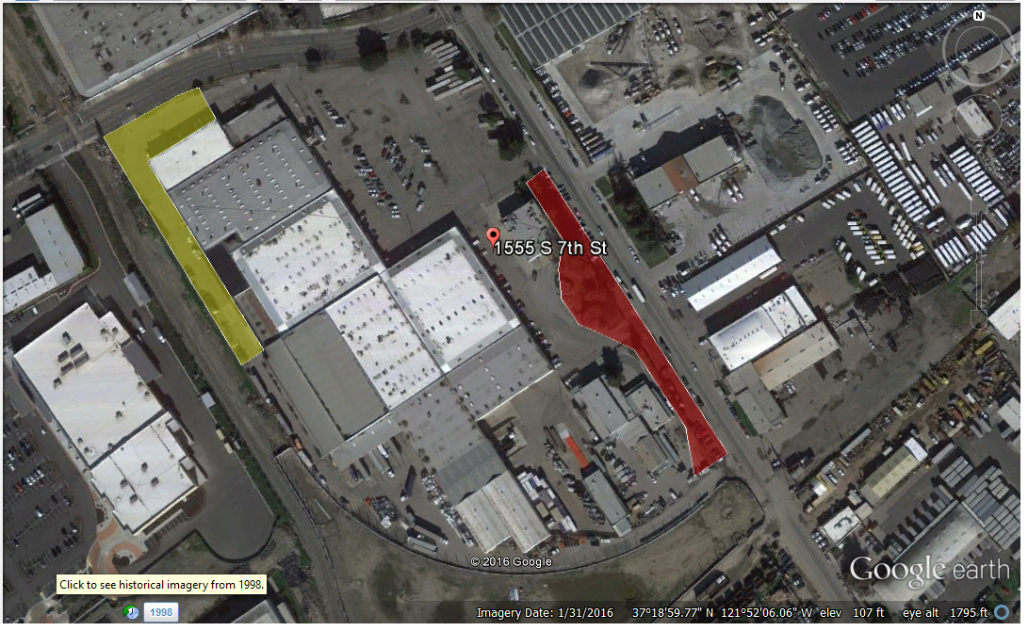
We had to find a way to cause less disturbance
New Area

Slide 36
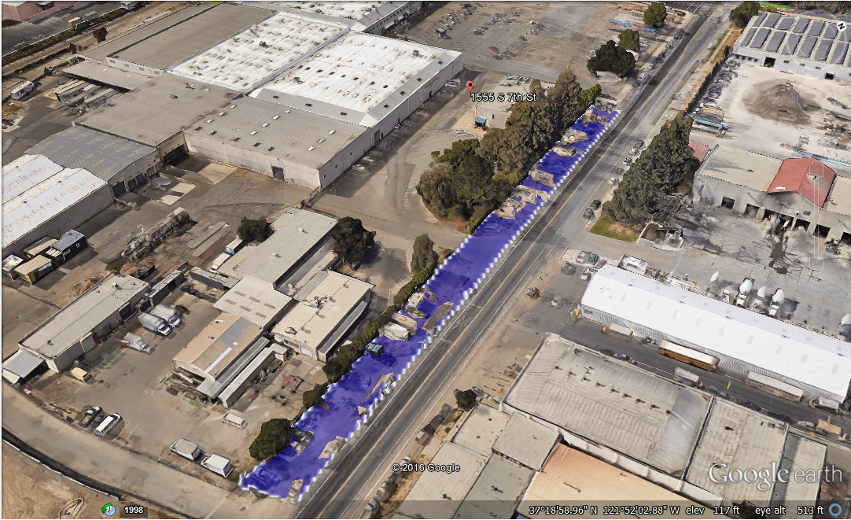
A new area from the city will be incorporated into the site

Slide 37
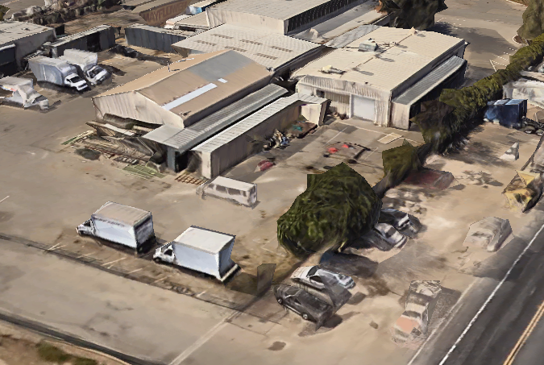
We have space to build two stations
Elevated Station
Ground Level Station

Slide 38
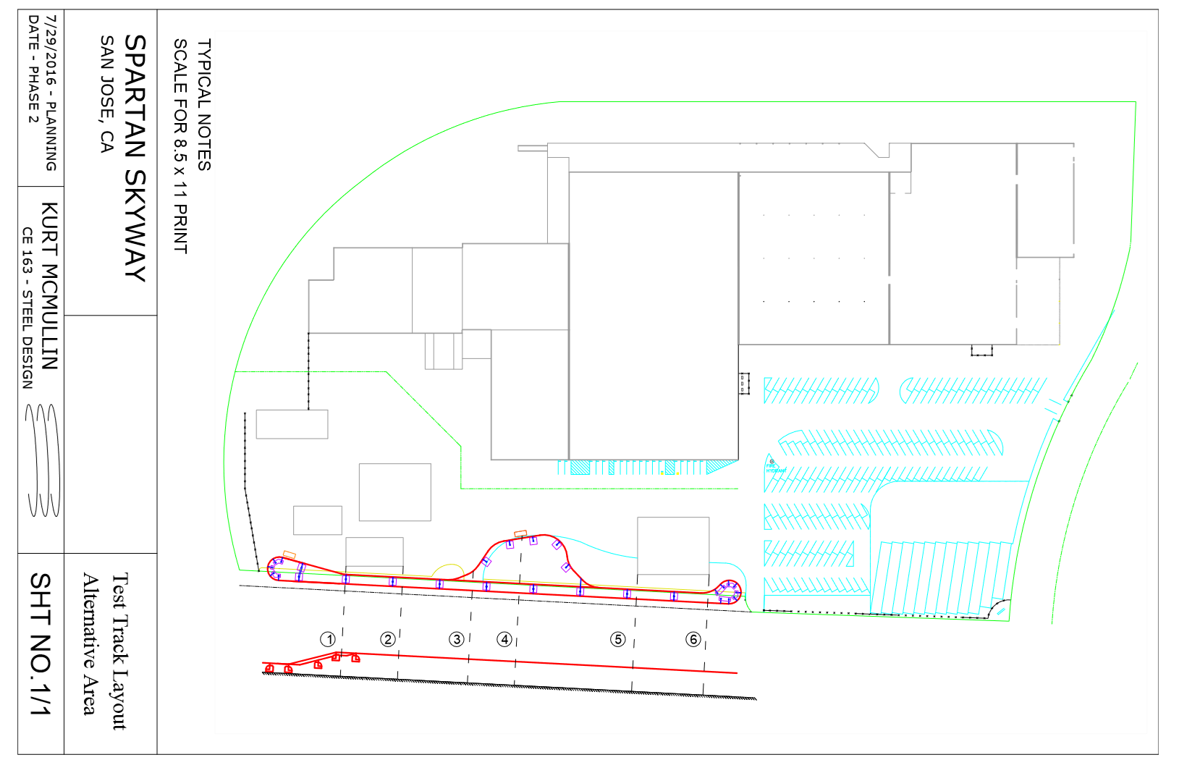
At this point, we are working on the new potential layout

Slide 39
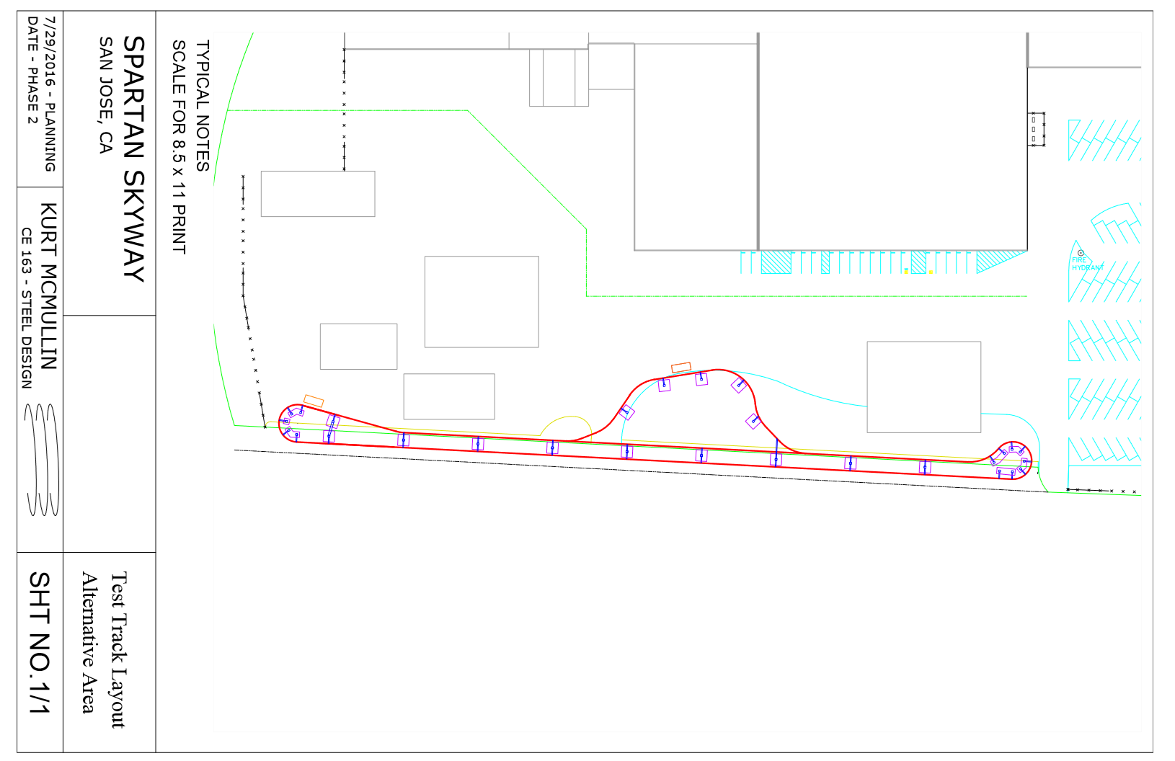
At this point, we are working on the new potential layout

Slide 40
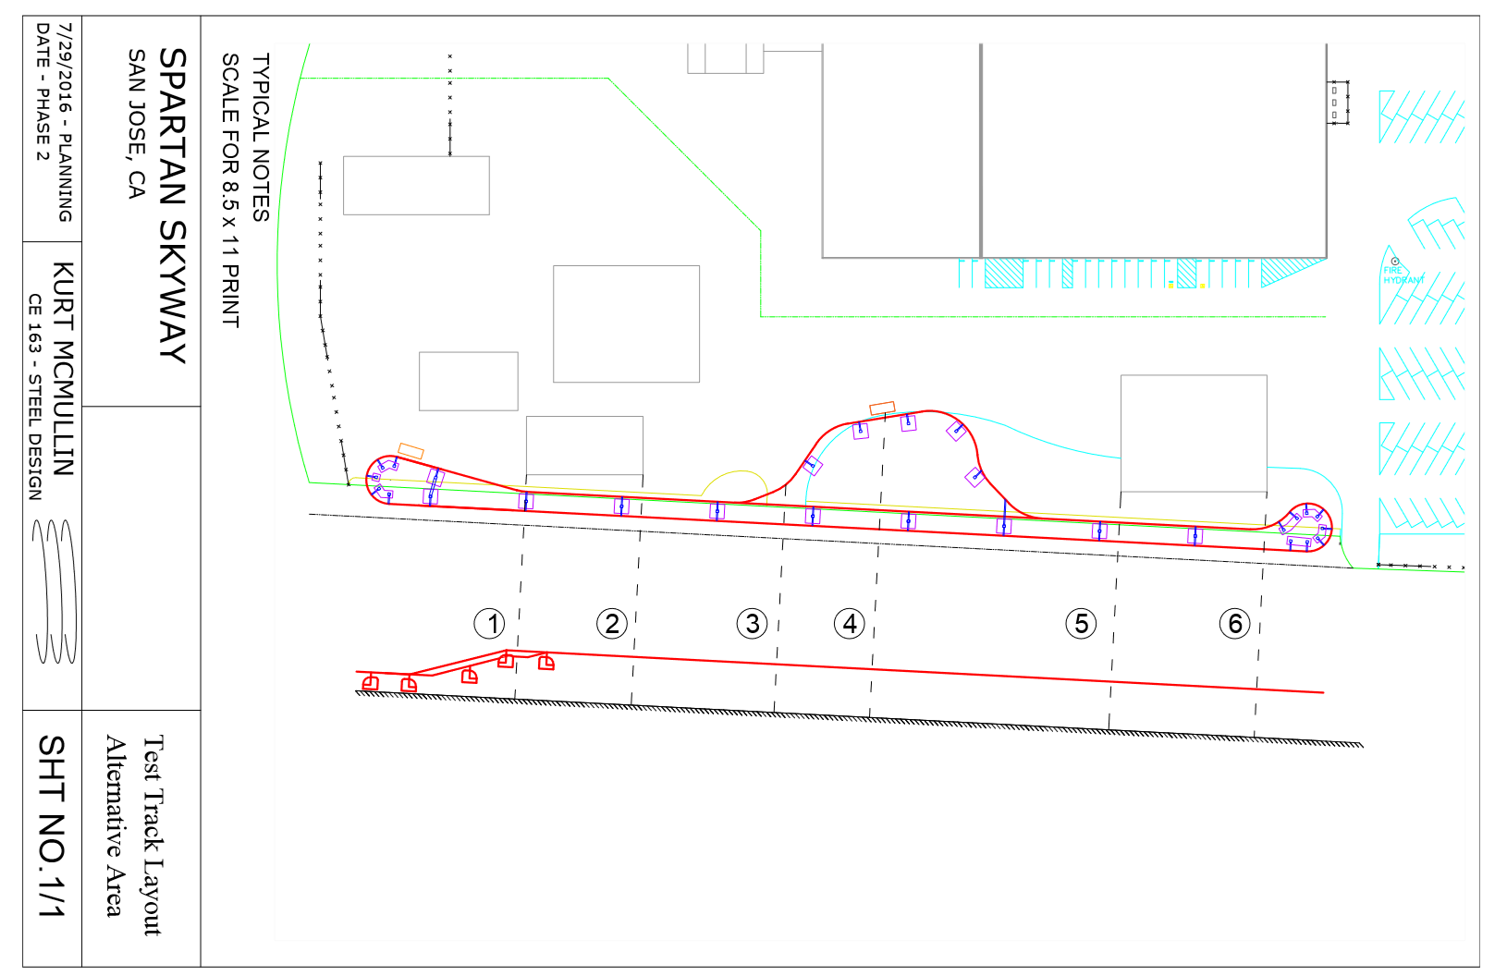
At this point, we are working on the new potential layout

Slide 41
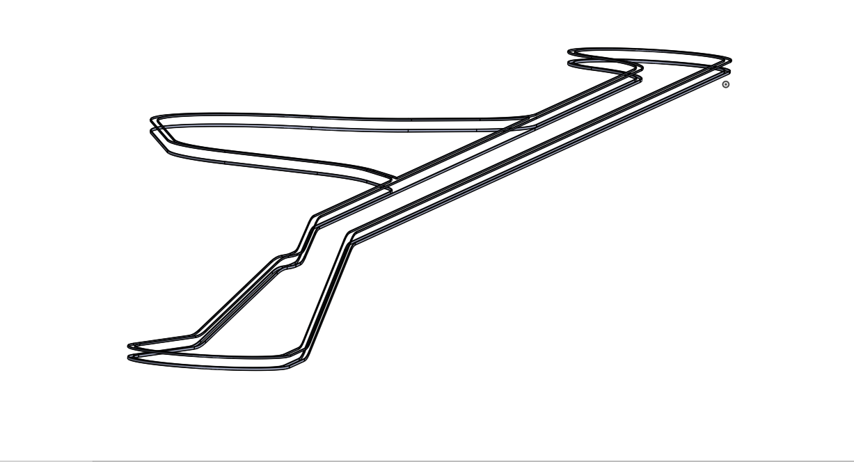
We draw a 3D model on Solid Works

Slide 42
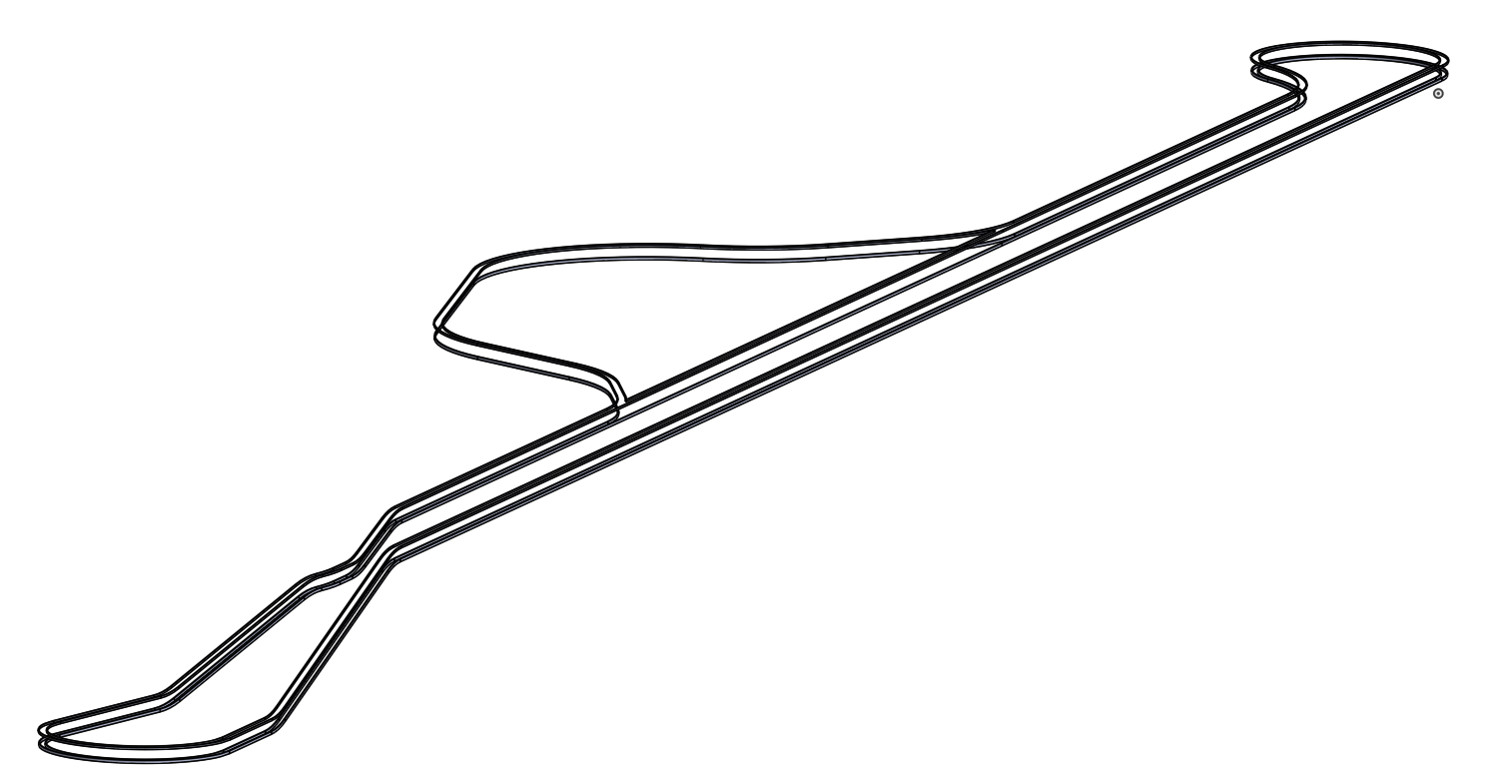
We draw a 3D model on Solid Works

Slide 43
We draw a 3D model on Solid Works

Slide 44
AGENDA
Potential Routes
South Campus
Test Track Layout
Environmental Studies

Slide 45
The main purposes of CEQA are:
Quantify significant environmental effects
Identify how can be avoid or reduced
Propose mitigation plans
Show the benefits of the project

Slide 46
How does the process work?
Comments Period
(30 days)
Public Scooping Meeting
Notice of Preparation
Preparation/ Release of EIR Draft
Public Hearing
Public Comment Period
(15 days)
Final Draft
Respond Comments

Slide 47
We need to follow 4 steps to describe the impacts
IMPACTS
Level
Monitoring Plans
Explanation
Mitigation

Slide 48
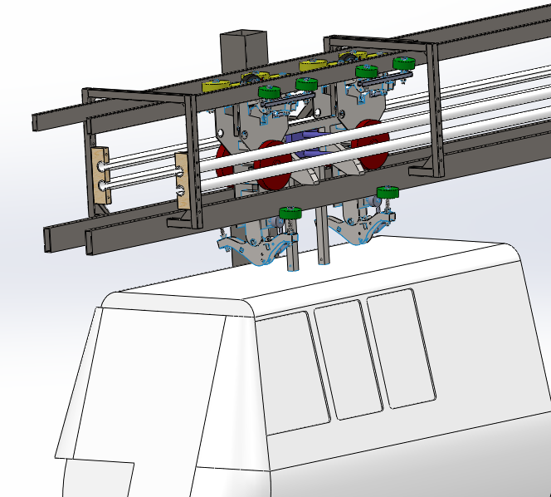
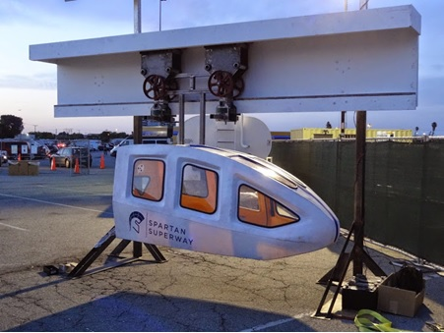
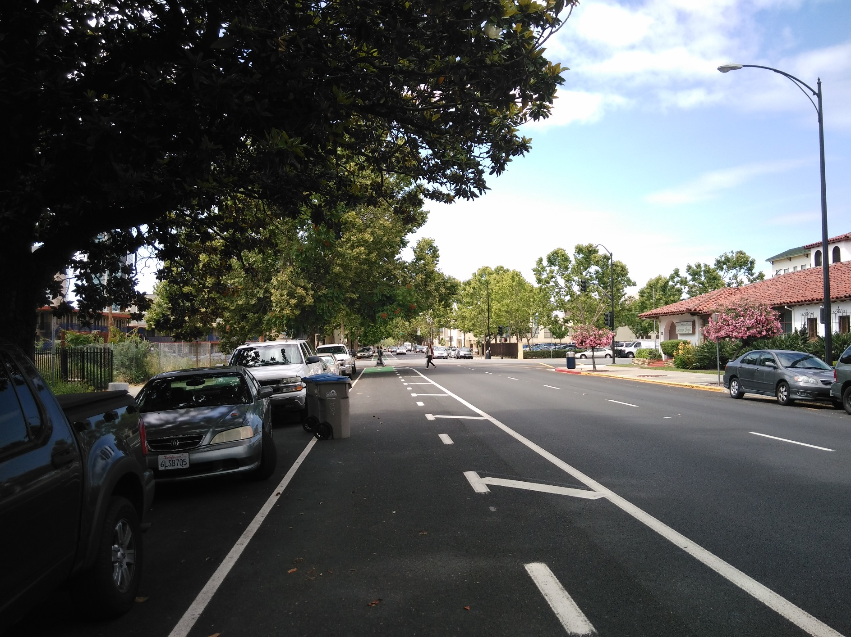
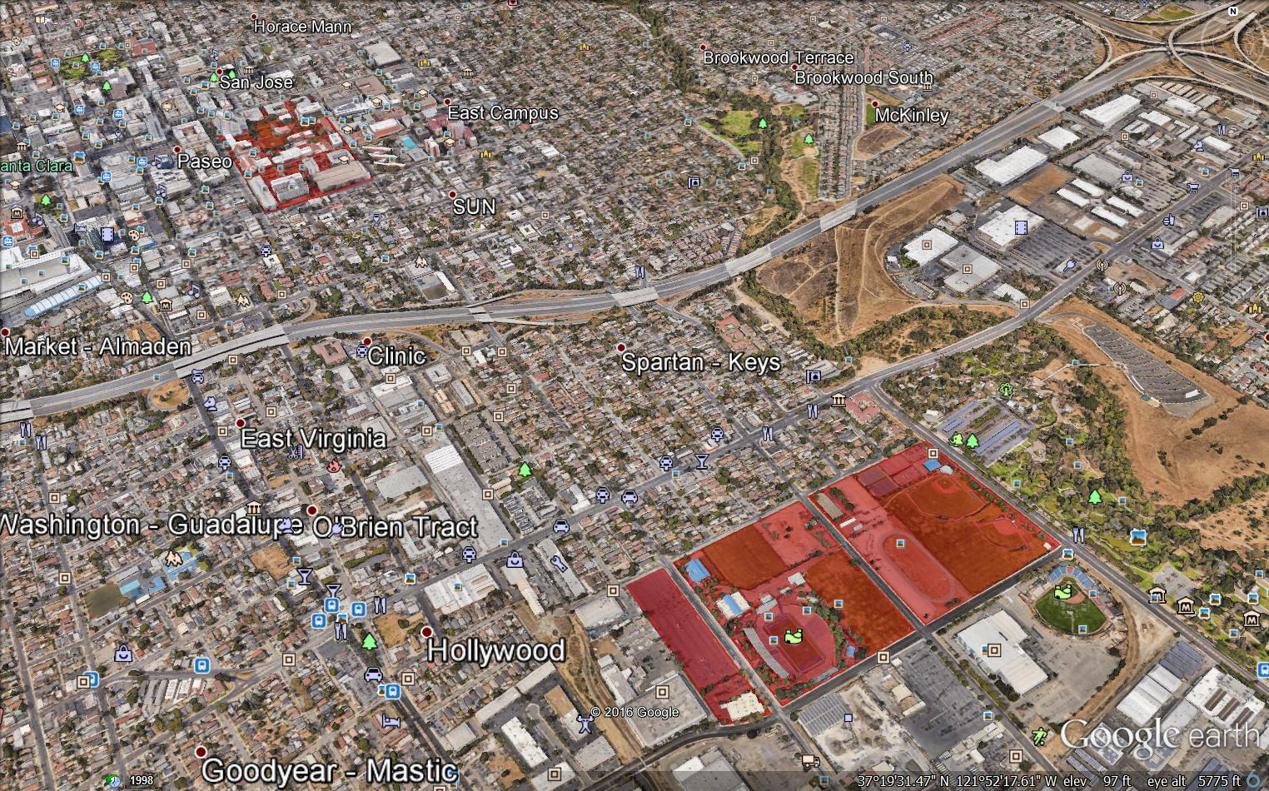
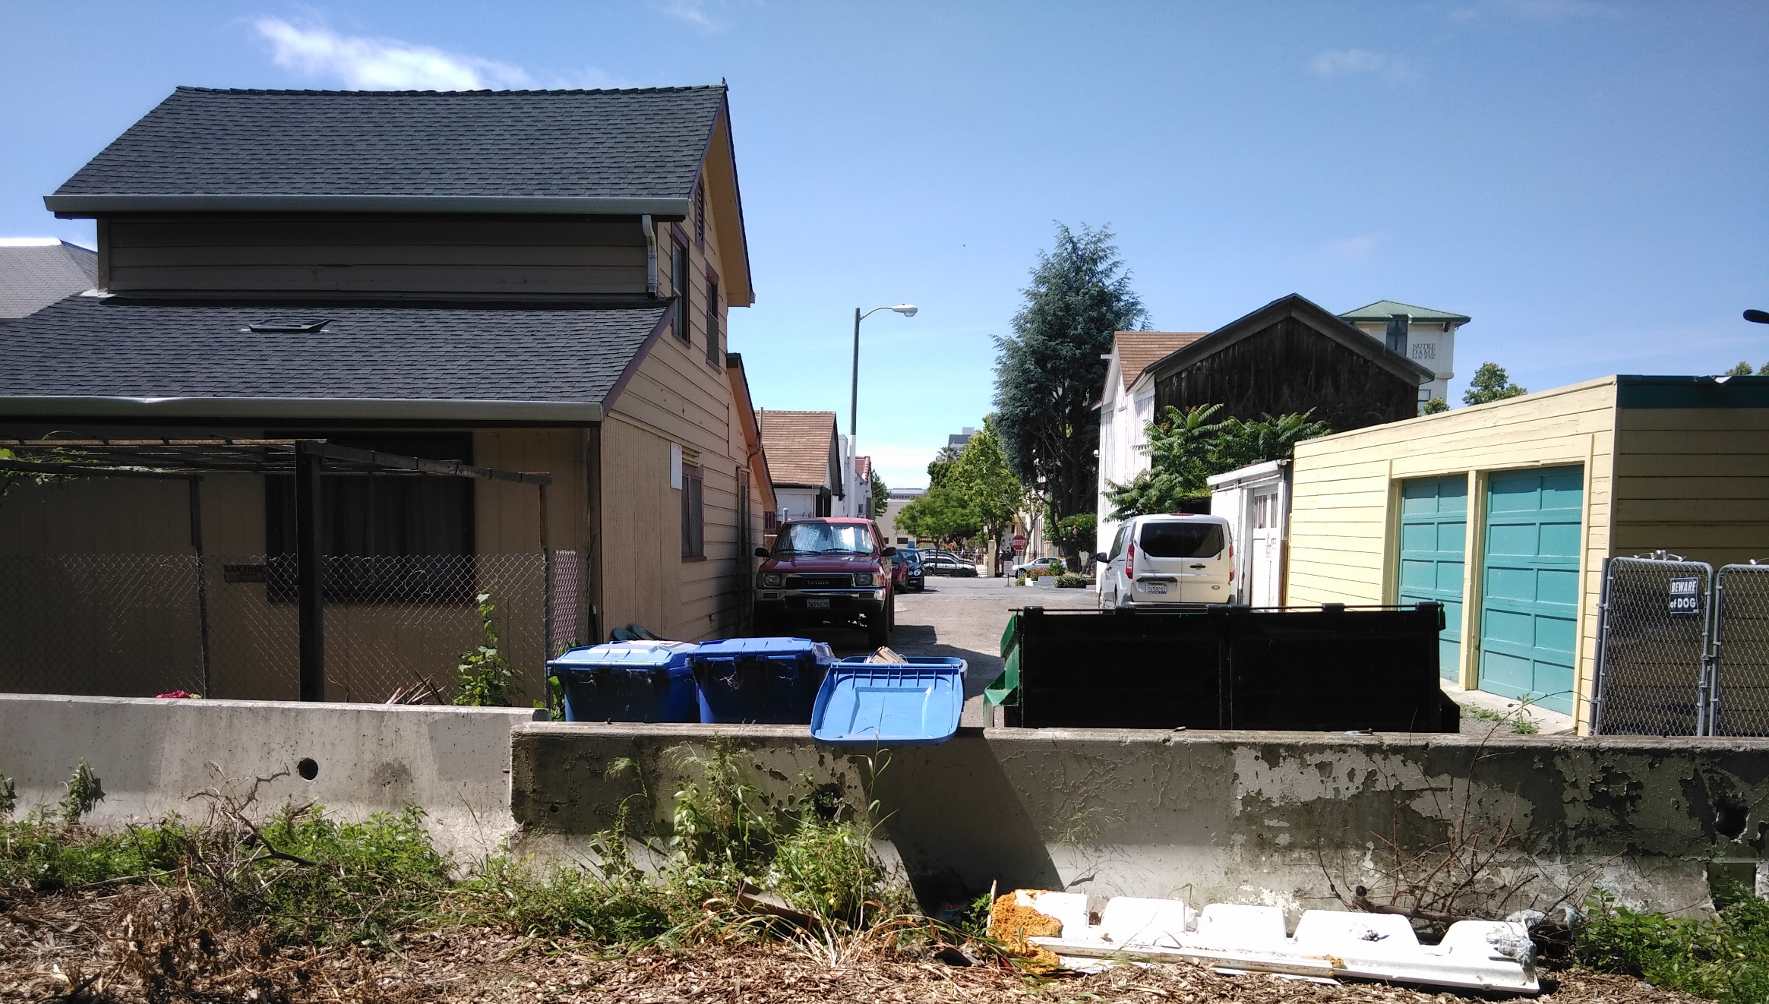
The main factors to be analyzed on EIR are:
Air Quality
Noise
Population and Housing
Transportation and Circulation
Land Use
Aesthetics
To include: Utilities and Services Systems
Biological Resources

Slide 49
The main factors to be analyzed on EIR are:
Air Quality
Noise
Population and Housing
Transportation and Circulation
Land Use
Aesthetics
To include: Utilities and Services Systems
Biological Resources

Slide 50
What are the environmental concerns for the Test Track?
CONDITIONAL USE PERMIT
NOISE AND VIBRATION
SPACE
CONSTRUCTION

Slide 51
The next steps to getting the Use Permit is go to City Hall with all documentation required and ask them what is the process to obtain the Use Permit to build our Test Track

Slide 52
Thank you!

